Slide 1



AGE
Notes:
Teacher’s notes:
Printed vision board:
Print this template.
Students can write, draw or stick ideas onto their template. We’d recommend printing on A3, but A4 can also work.

Slide 2
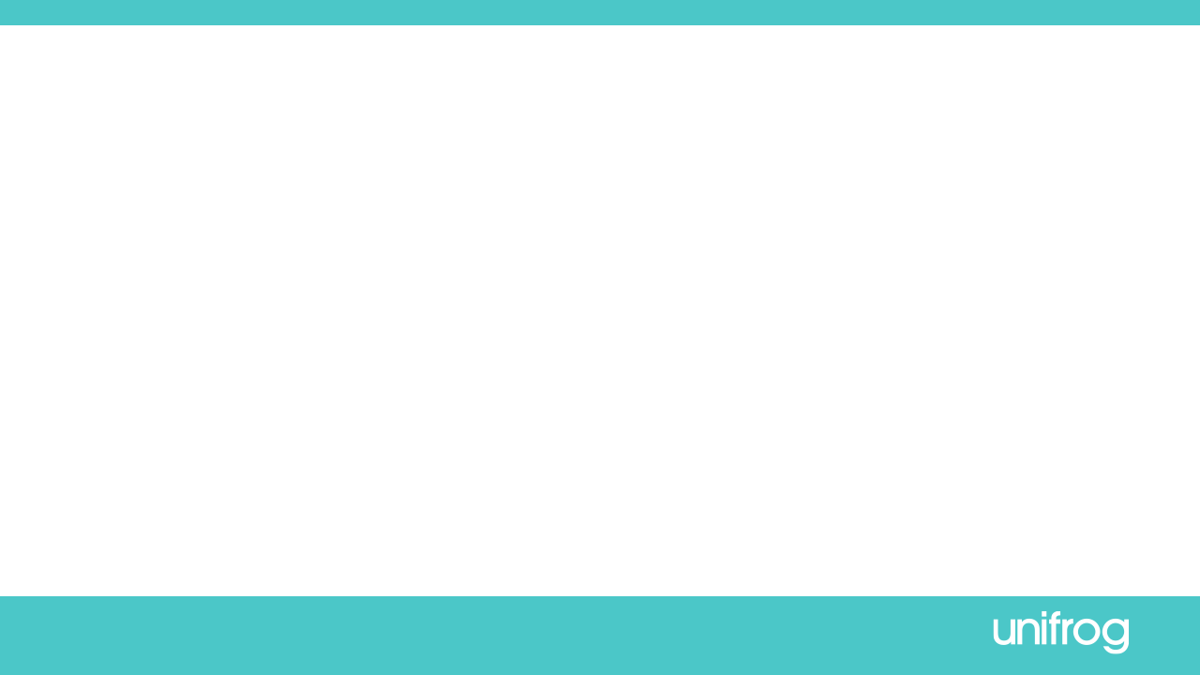











I’m living with …!
I love living with them because…
A good day for me looks like …
The most important people in my life are …
I’m working as ….
I’ve been qualified for …….
I struggled with …
I overcame …
AGE
I love ……….
I do it most on …………
My biggest role model is
…
I’m happy with my life because…
Digital template 1
Notes:
Teacher’s notes:
Digital template 1:
Send this slide to students or upload as an interaction on Unifrog. Click Advanced view>Sort by school leaving year>[filter for specific students]>+interaction.
Students can change graphics by right-clicking on the icon and clicking Change graphic.
Students can use these sentence prompts, or come up with their own ideas.
This is good for students who prefer writing and using words.

Slide 3
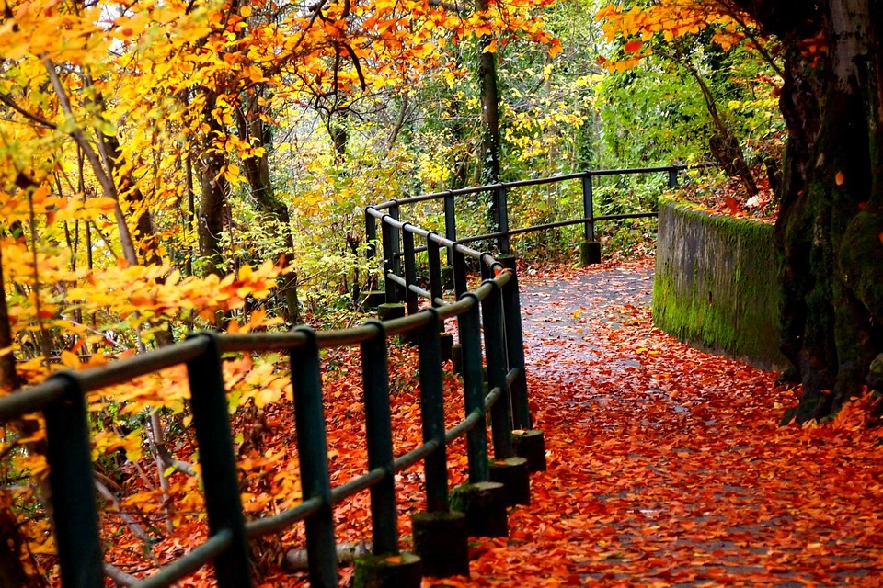
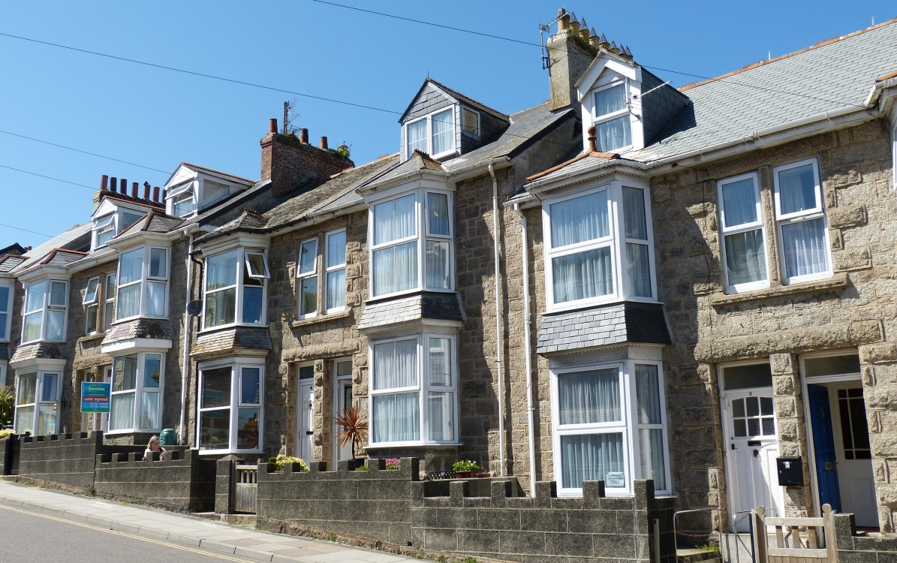
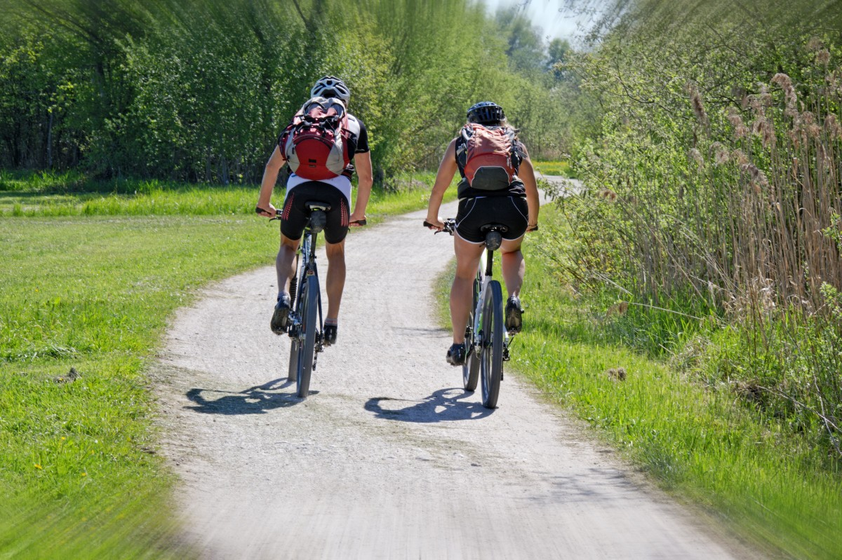

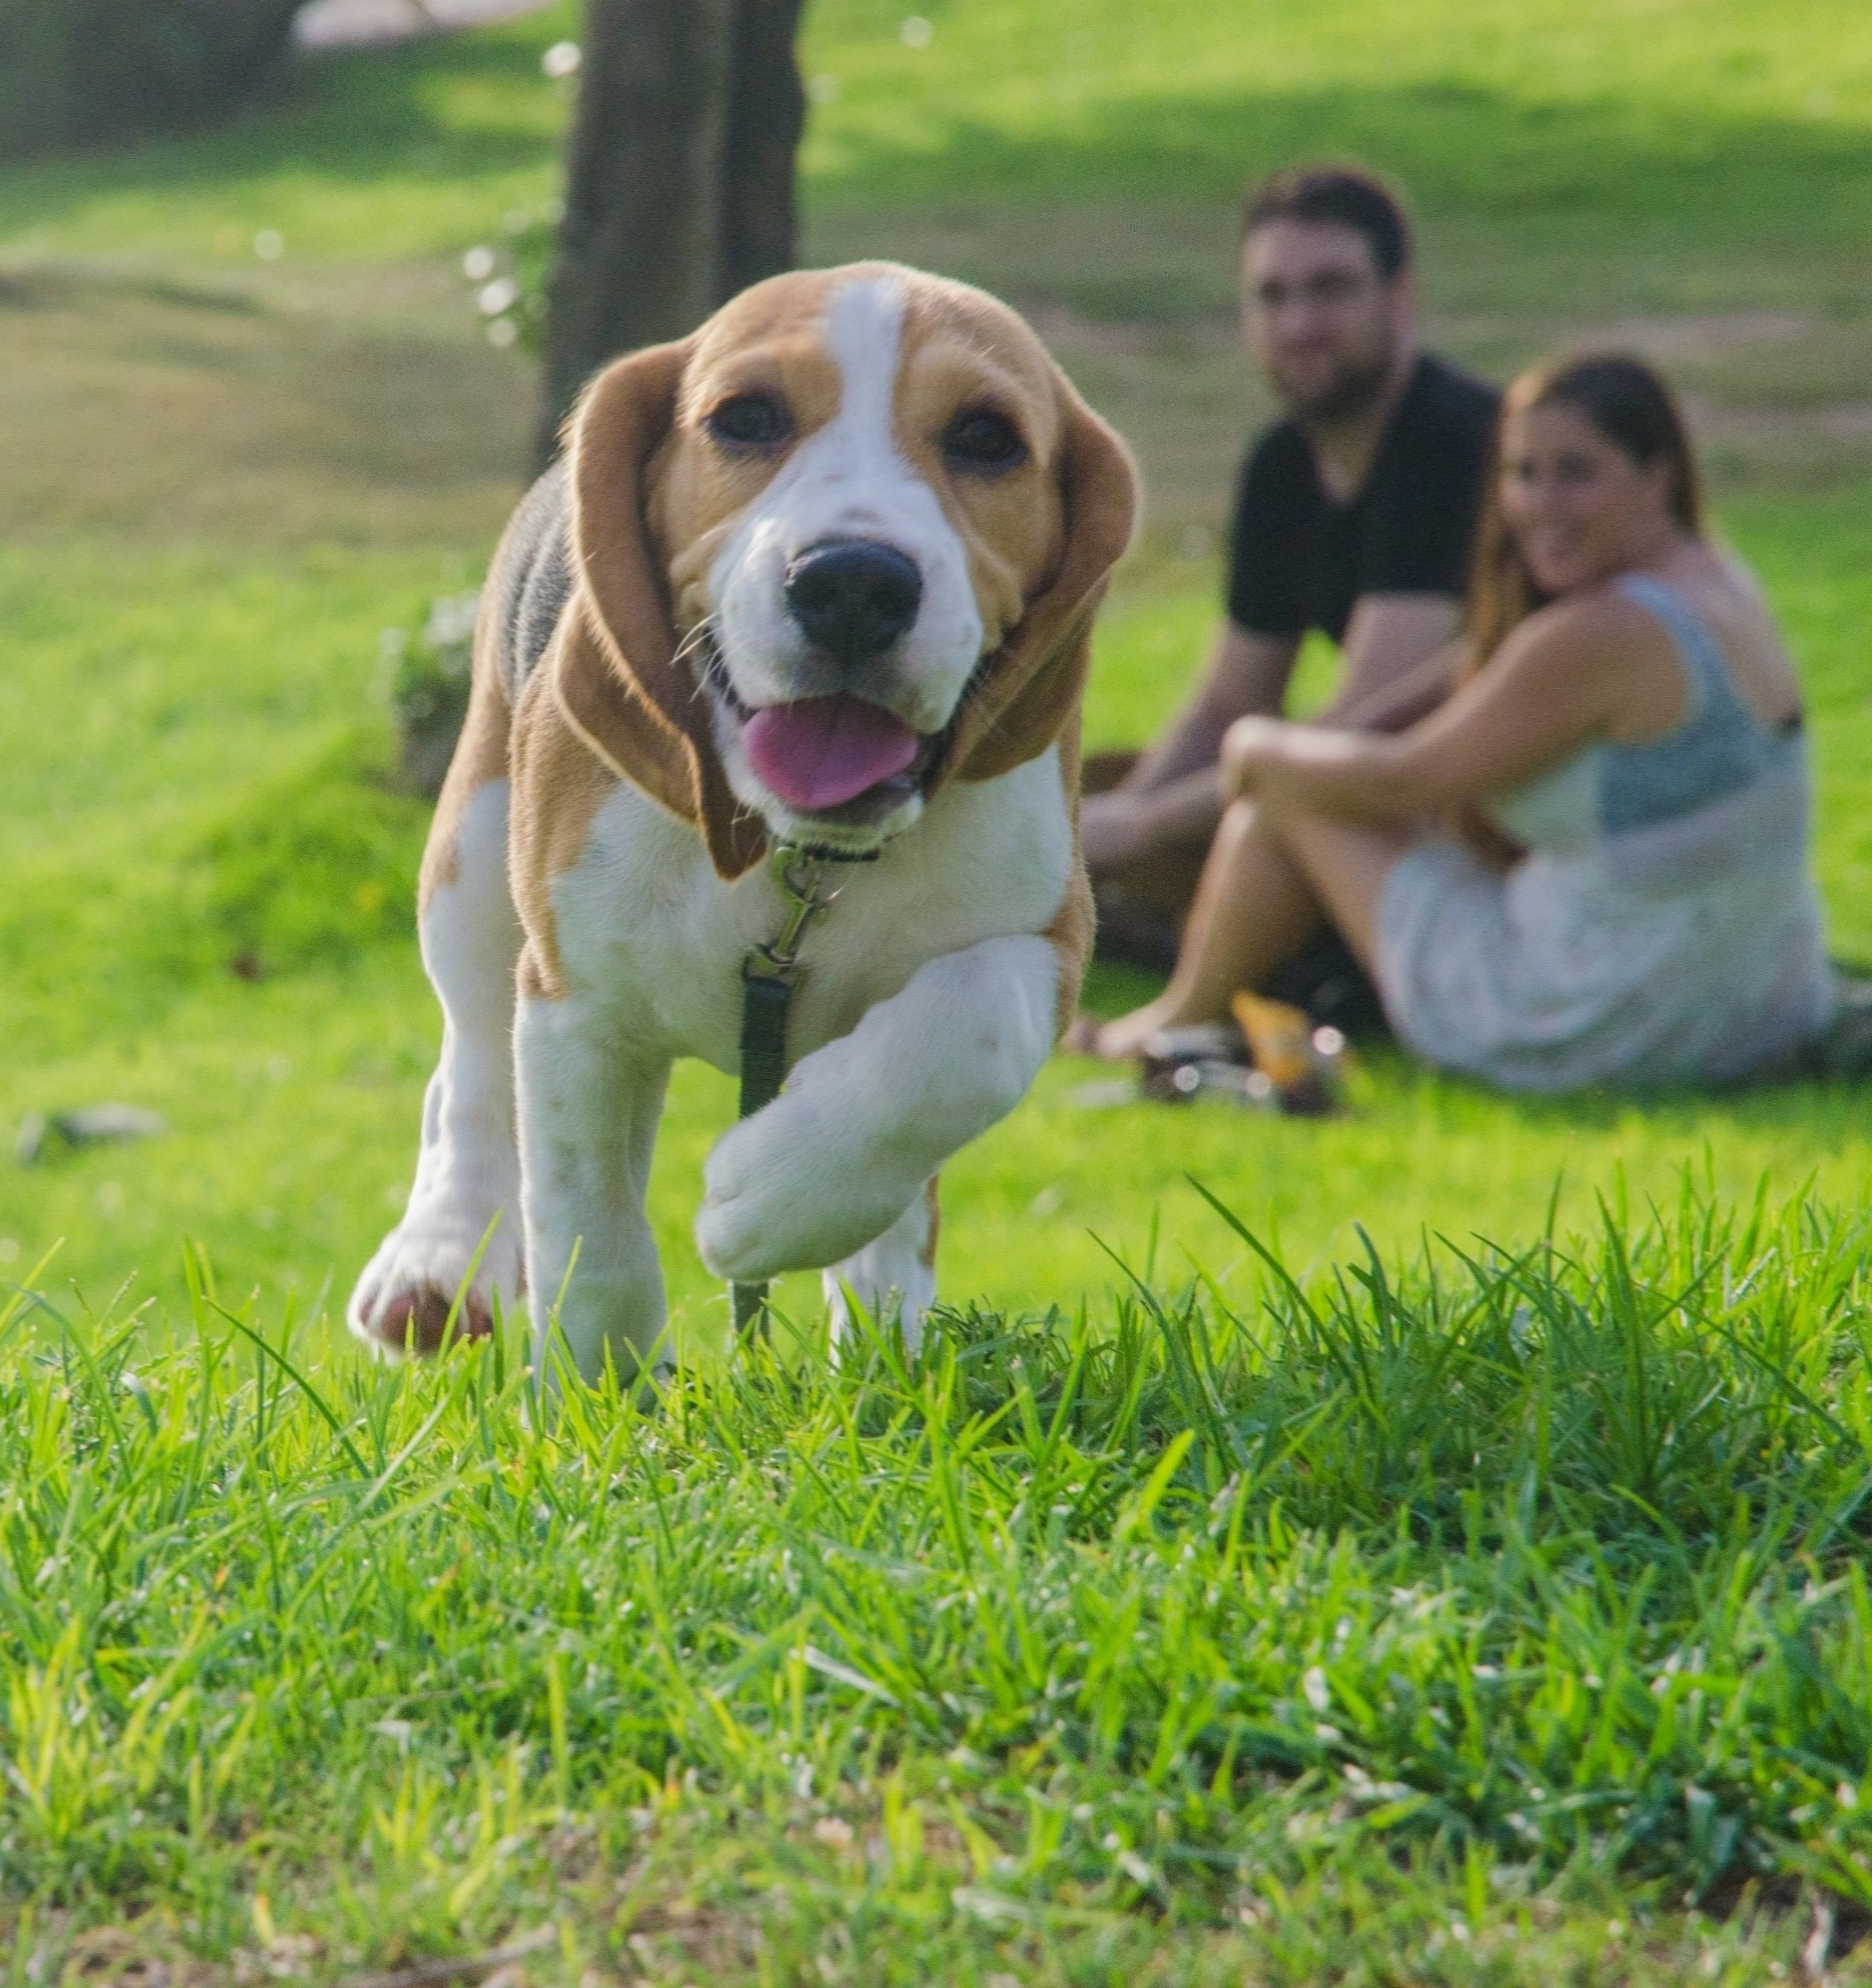
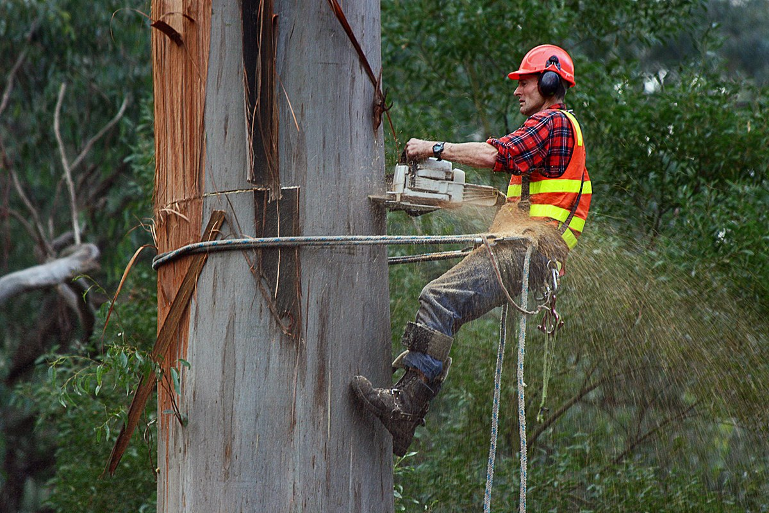
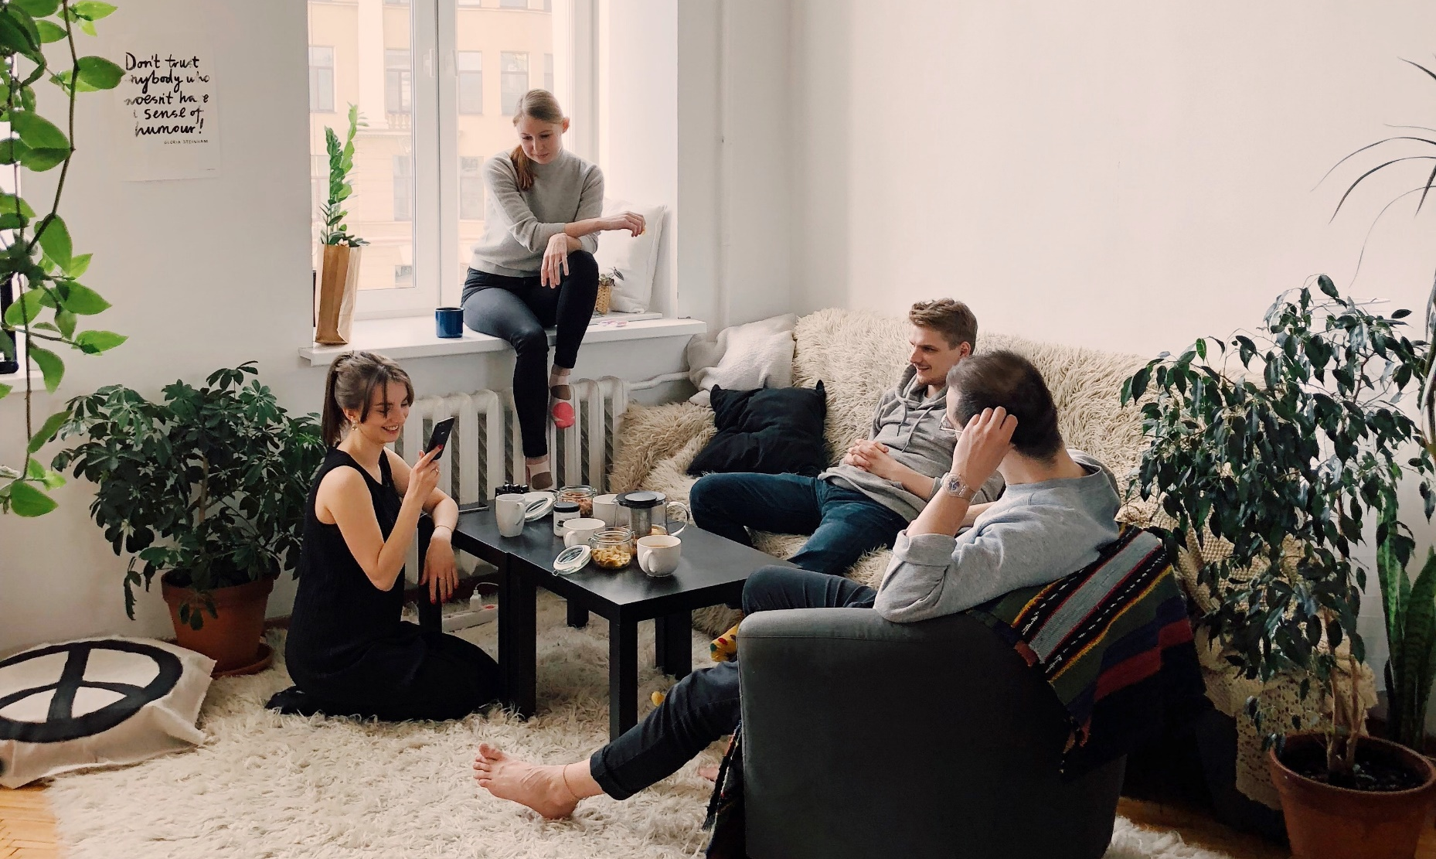
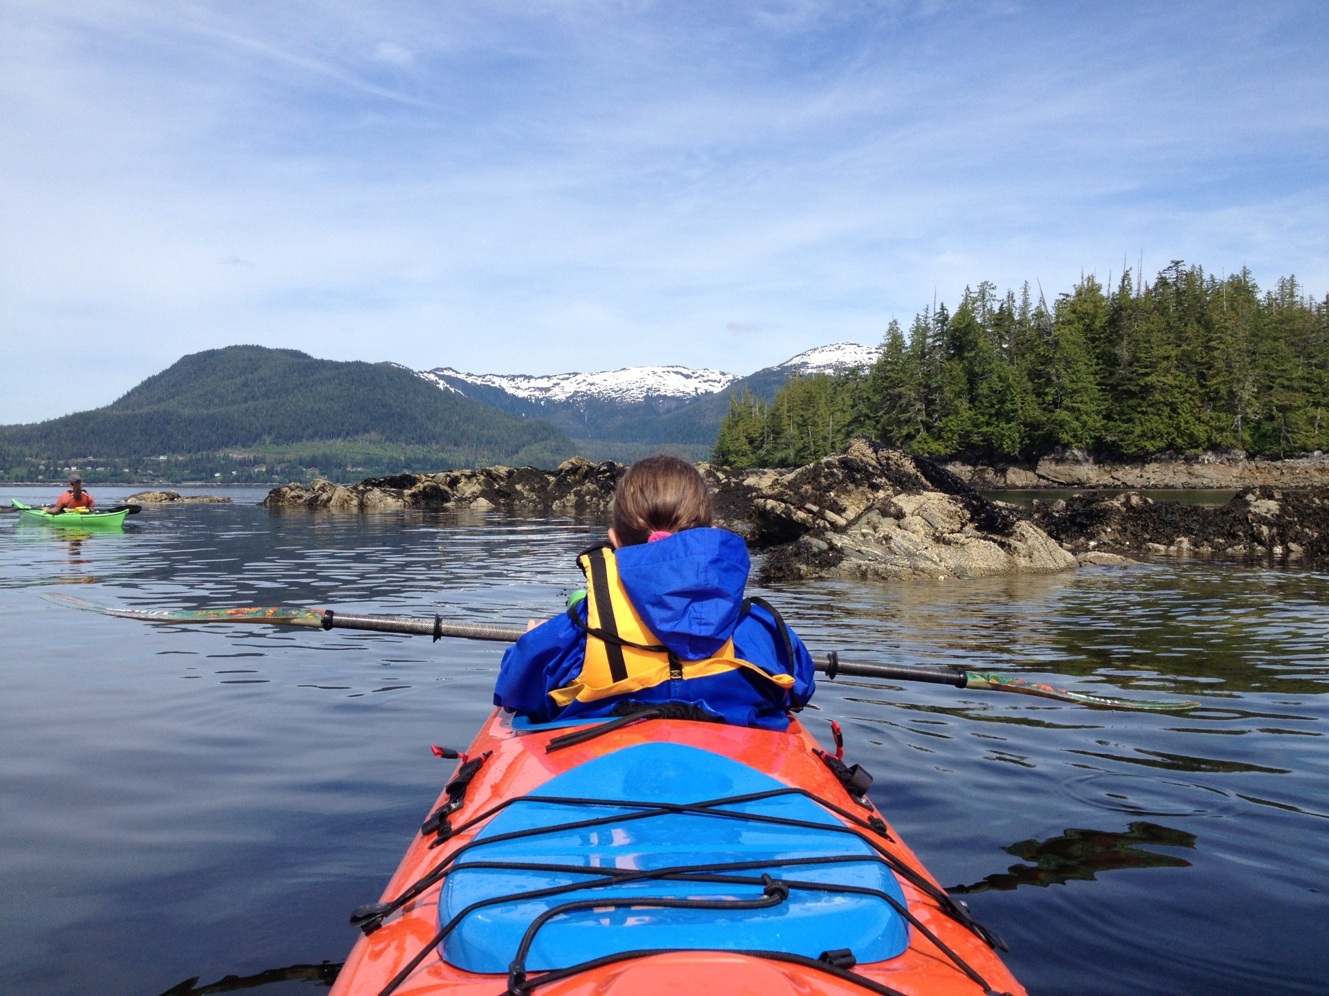
Age 25
Digital template 2
Notes:
Teacher’s notes:
Digital template 2:
Send this slide to students or upload as an interaction on Unifrog. Click Advanced view>Sort by school leaving year>[filter for specific students]>+interaction.
Students right-click on a photo and press ‘change picture’.
Students can use the images as prompts or start from scratch with their own ideas.
This is good for students who prefer using images to convey ideas.

