Slide 1
Tutor notes
Hi
Am very much hoping there aren’t problems with the google form, please let me know if you find a glitch! Ext: 2703
You’ll have to get the generation game clip to 49 minutes to show the conveyor belt part.
Worth having a look at slide 5 beforehand, there’s a bit of a delay after you click, then everything should scroll across magically. (fingers crossed)
Please don’t let them make notes during the presentation.

Slide 2
The Generation Game Harris House Challenge
The Generation Game was a show that started in the 1970’s.
One of the challenges of the game show was when participants watched a conveyor belt of items go past them. They had 40 seconds to watch the items.
They were allowed to keep any items that they remembered.

Slide 3

Notes:
https://www.youtube.com/watch?v=Fh3udfNkPZQ&list=PLfBMYKDWh5Nm0aTmc6_fb5THmPmOT0-D8 Play this clip from 49 minutes to show the conveyor belt challenge

Slide 4
You are about to see pictures of 20 items.
They will move across the screen.
You may not make notes.
Once they have finished, you have 45 seconds to tell your tutor what you remember. Maybe a volunteer could write them on the board?
After you have your answers, your tutor will add them to the google form.
You may only watch the powerpoint once.
Good luck!

Slide 5
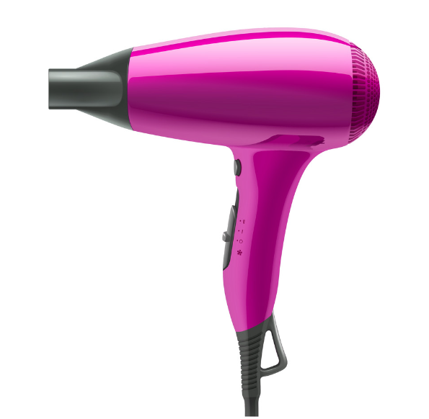
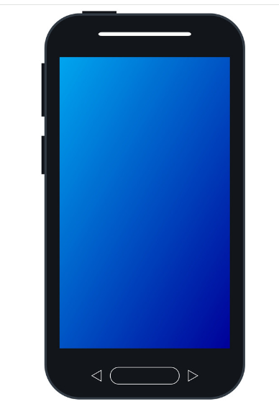


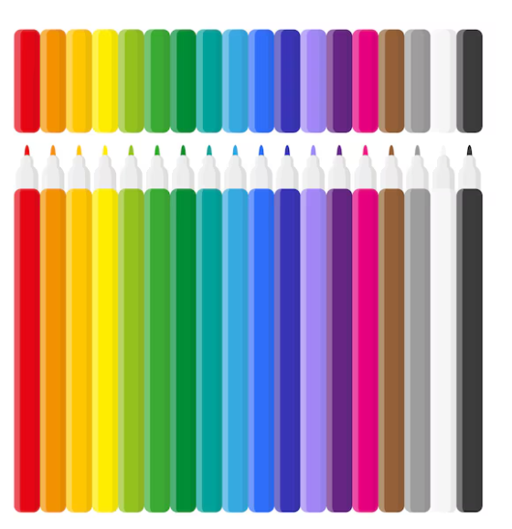

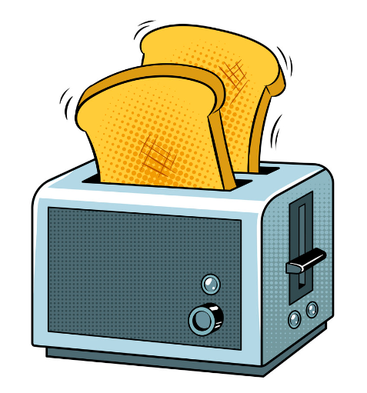


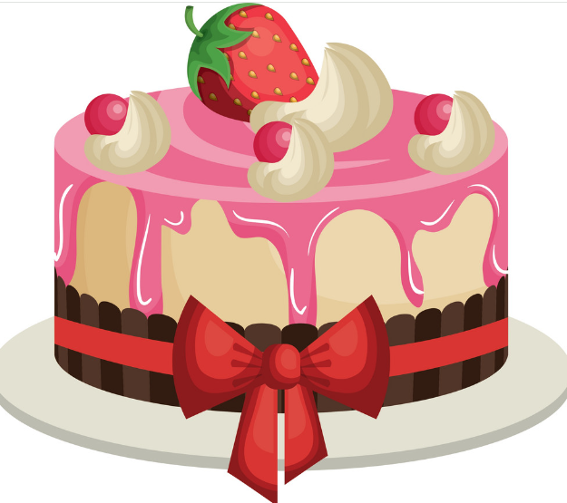


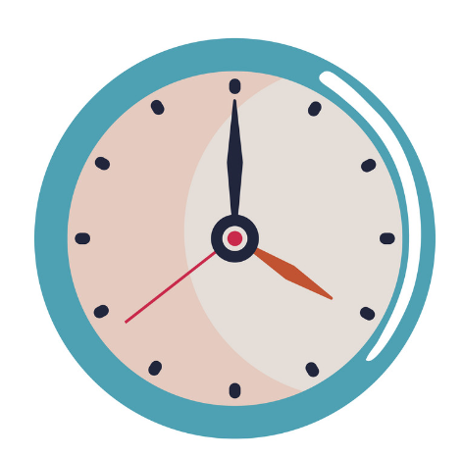


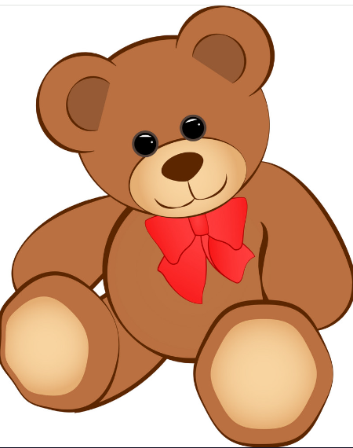

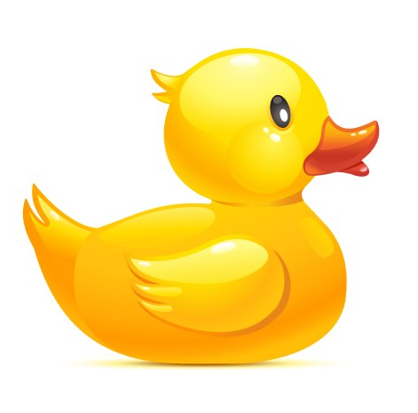
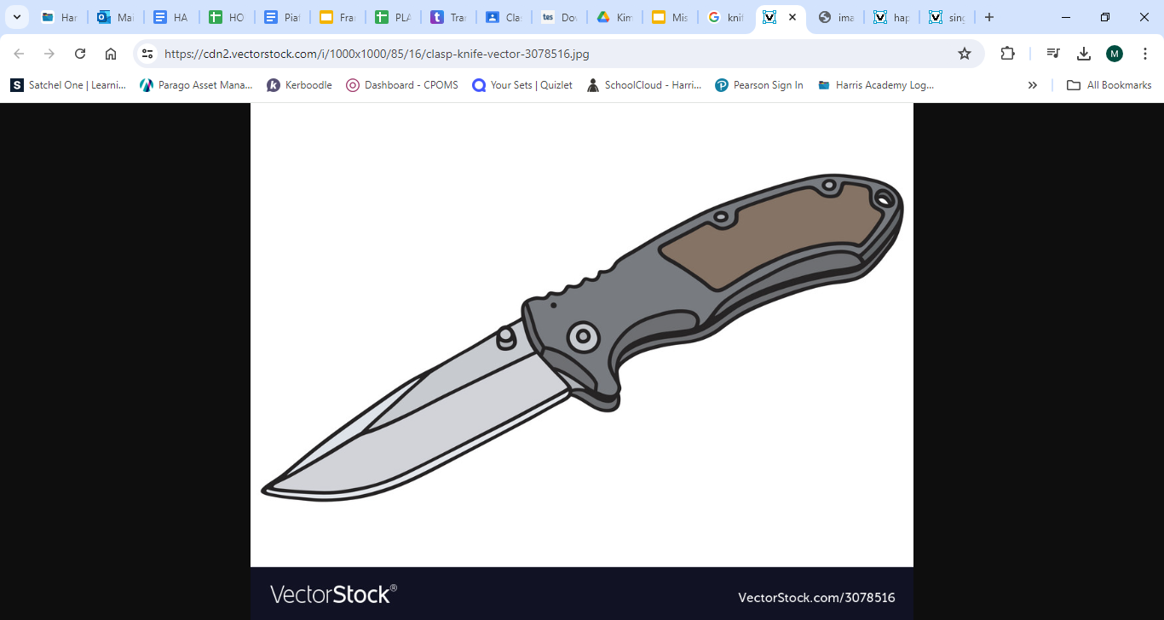
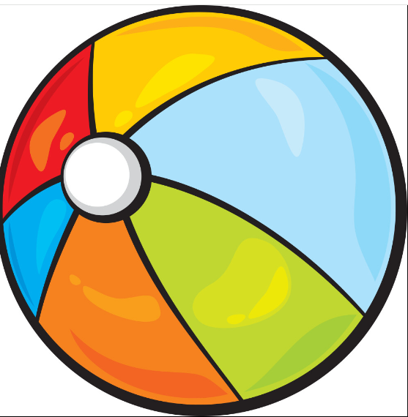
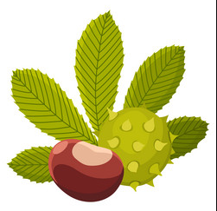
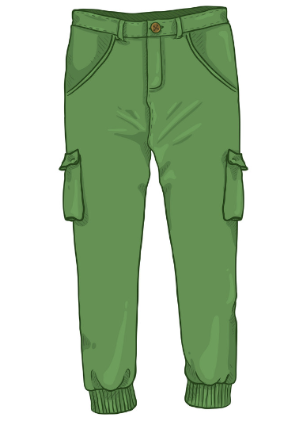
Notes:
Press once and then the slideshow will start.

Slide 6
Get ready…
Notes:
Or teacher could write their guesses on whiteboard

Slide 7

You now have 45 seconds to tell your tutor the answers

Slide 8
Tutors! Now please submit all your guesses onto the Google Form here:
https://docs.google.com/forms/d/1XVXcsa9DkYC-hxZJMnbJ_u0rYzRpkli_s_q0xDZNWDc/edit

