Slide 1

The power of kindness
The short clip serves as a reminder of the power of being kind.

Slide 2
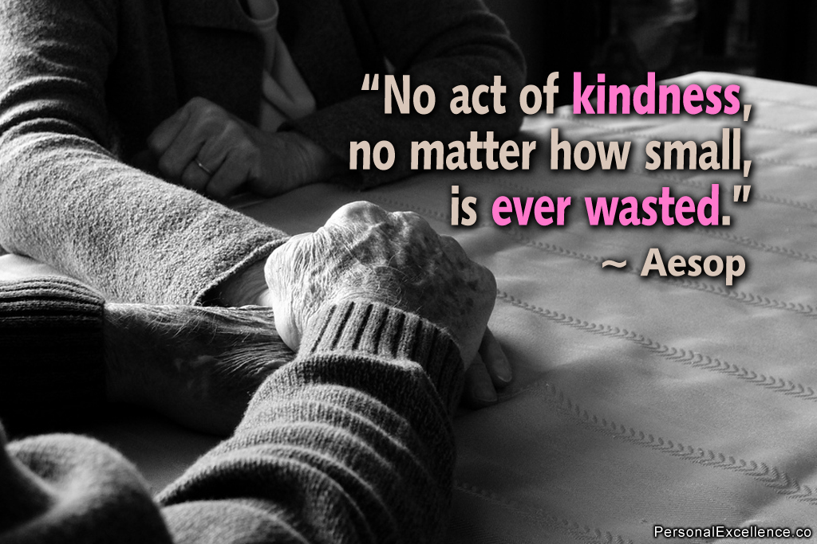
Being kind to others shows strength of
Character

Slide 3
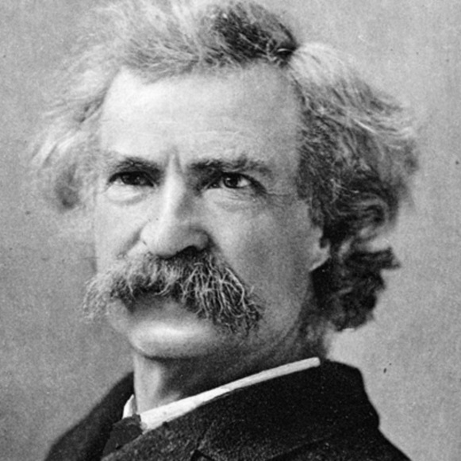
As Mark Twain put it: "Kindness is the language which the deaf can hear and the blind can see."
For no matter what physical or mental state we may be in, kindness is something we can all understand. It generates profound experiences as both giver and receiver.

Slide 4

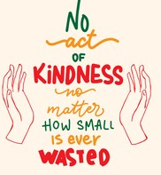
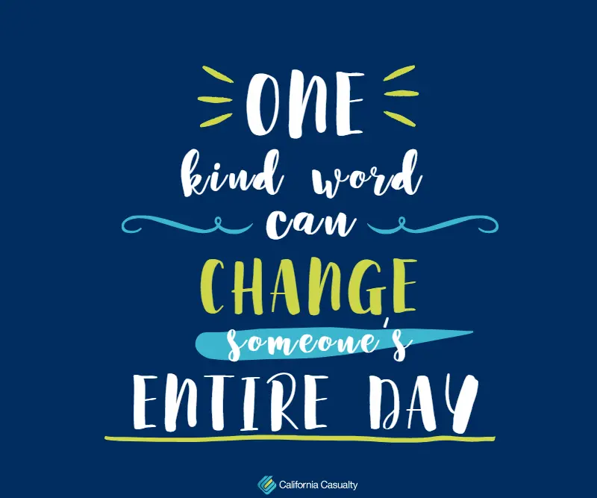
Which acts of kindness do you appreciate from the examples of the following slides?
Notes:
You can ask students for their opinions

Slide 5
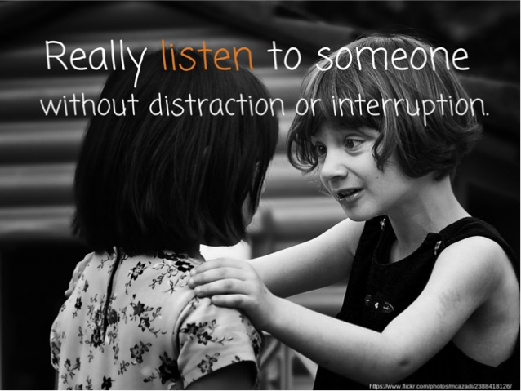

Slide 6
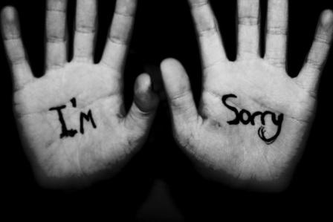
Forgive someone

Slide 7
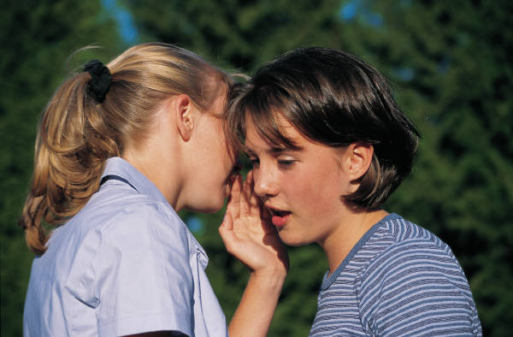
Be unfailingly polite to every single person that you meet
Swap places with the person behind you in the queue
Say something nice about someone behind their back

Slide 8
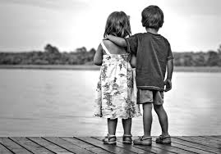
Spend time with a friend who needs you

Slide 9
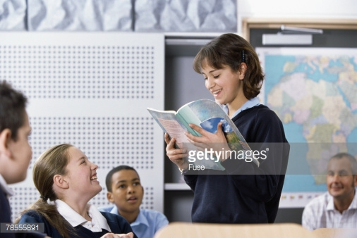
Help someone with their reading, school or homework

Slide 10
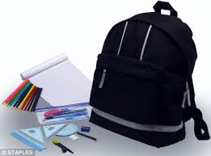
Lending equipment to someone who needs it

Slide 11
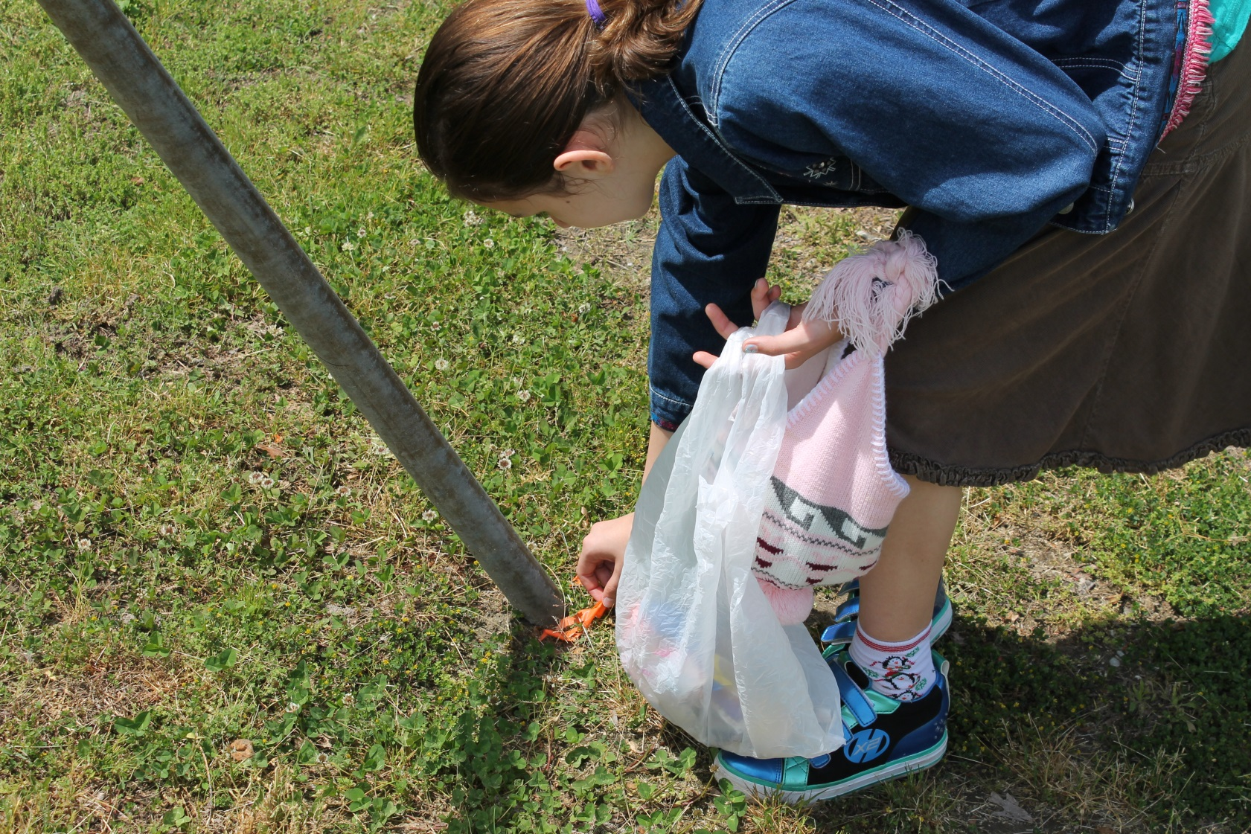
Pick up some litter – even if it’s not yours!

Slide 12
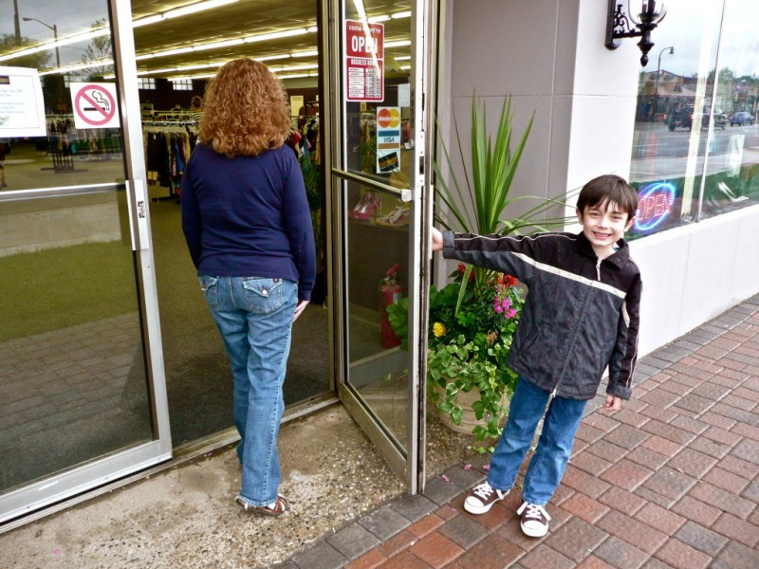
Hold the door open for others

Slide 13
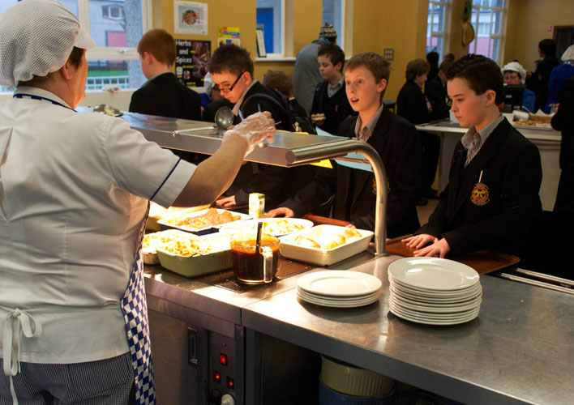
In the canteen, offer to take someone else’s tray back with yours.

Slide 14
Smile at everyone you see

Slide 15
What other words for kindness can you come up with:
Here are a few ideas:
affection
benevolence
decency
gentleness
grace
goodness
tenderness
humanity
unselfishness
thoughtfulness

Slide 16

There are mental and physical benefits to being kind to others:
Reduces stress at school
Increases your self worth and self esteem
Makes you feel better and happier about yourself
Decreases feelings of loneliness, depression and being helpless
Improves your sense of being connected to others

Slide 17
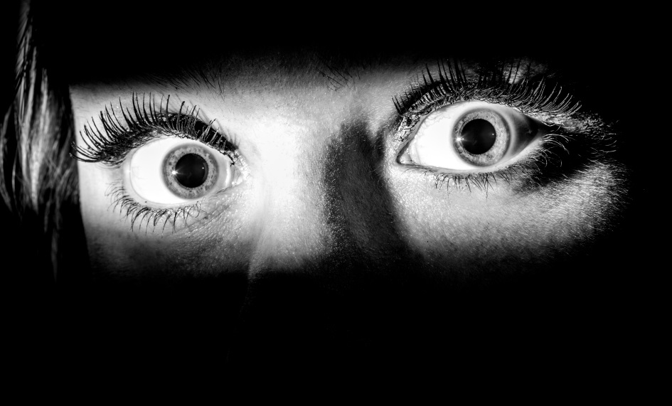
The opposite of kindness is “Fear “
Those who say:
“I’m not picking that up”
“ nothing to do with me”
“ I’ll show him respect if he shows me some first”
“ I’m not saying sorry”
I’ll give as good as I get “
These people are afraid of showing kindness because it makes them feel vulnerable and weak.

Slide 18
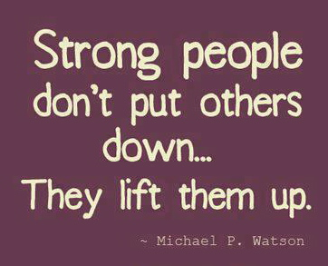

Slide 19
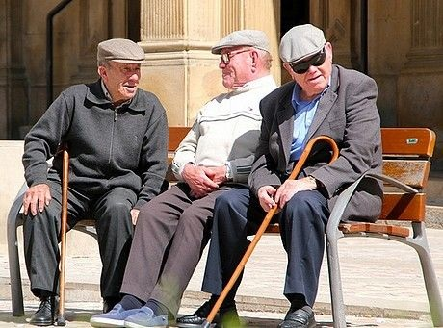

What can other countries teach us about kindness towards others ?
In Greece kindness towards the elderly is very important and the older you are the wiser and more valuable you become.

Slide 20
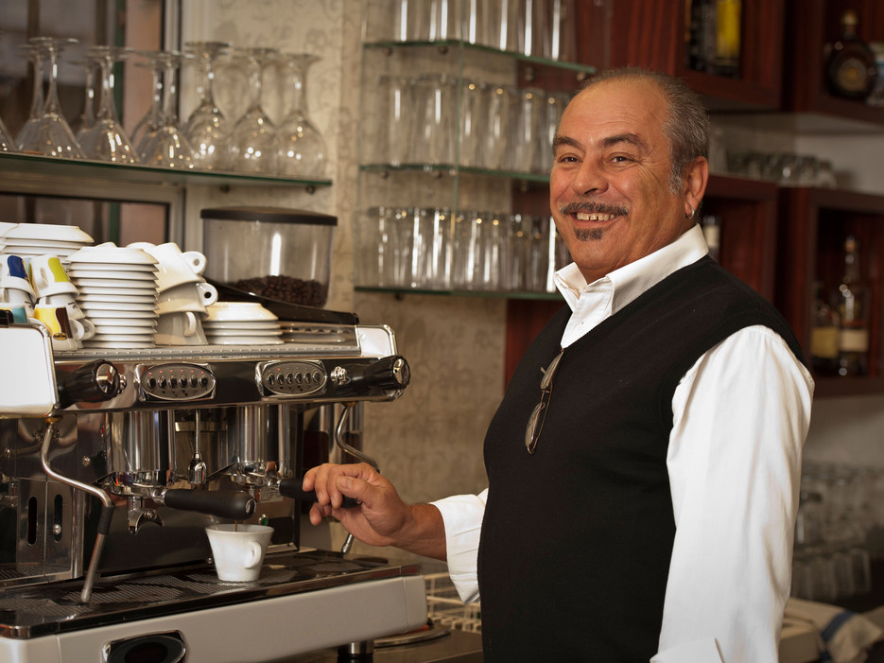
In Naples, Italy customers pay in advance for the poor to have
a free coffee by putting in their receipts into a pot
Caffe sospeso - suspended coffee for the needy

Slide 21
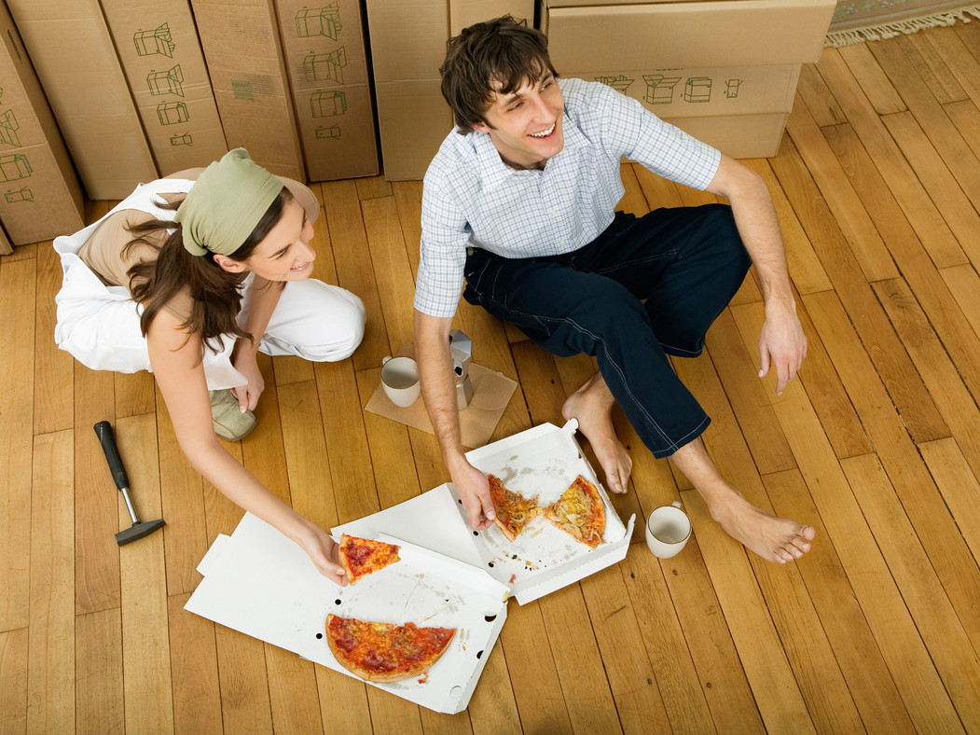
International company “ Reddits “ random acts of Pizza kindness :
where hungry poor people can ask for a pizza delivery paid for
by other internet users.

Slide 22

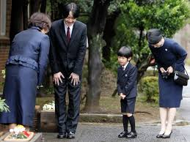
In Japan people show their kindness and gratitude by bowing to each other.
The younger person bows to the older person.

Slide 23

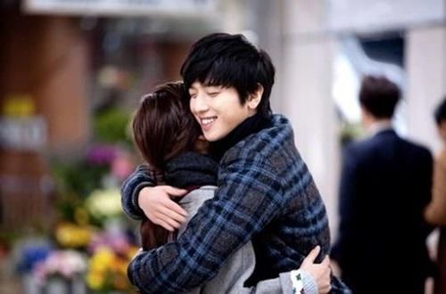
In South Korea the 14th day of every month is a day of kindness . There's a day for forgiveness and even a day for hugging.

Slide 24
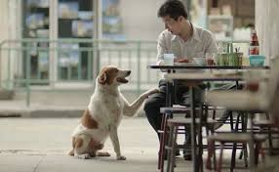
A simple act of kindness can create an endless ripple effect!

