Slide 1

Duke of Edinburgh Award Manager: David Unwin
Assistant Manager: Grace Keenan

Slide 2
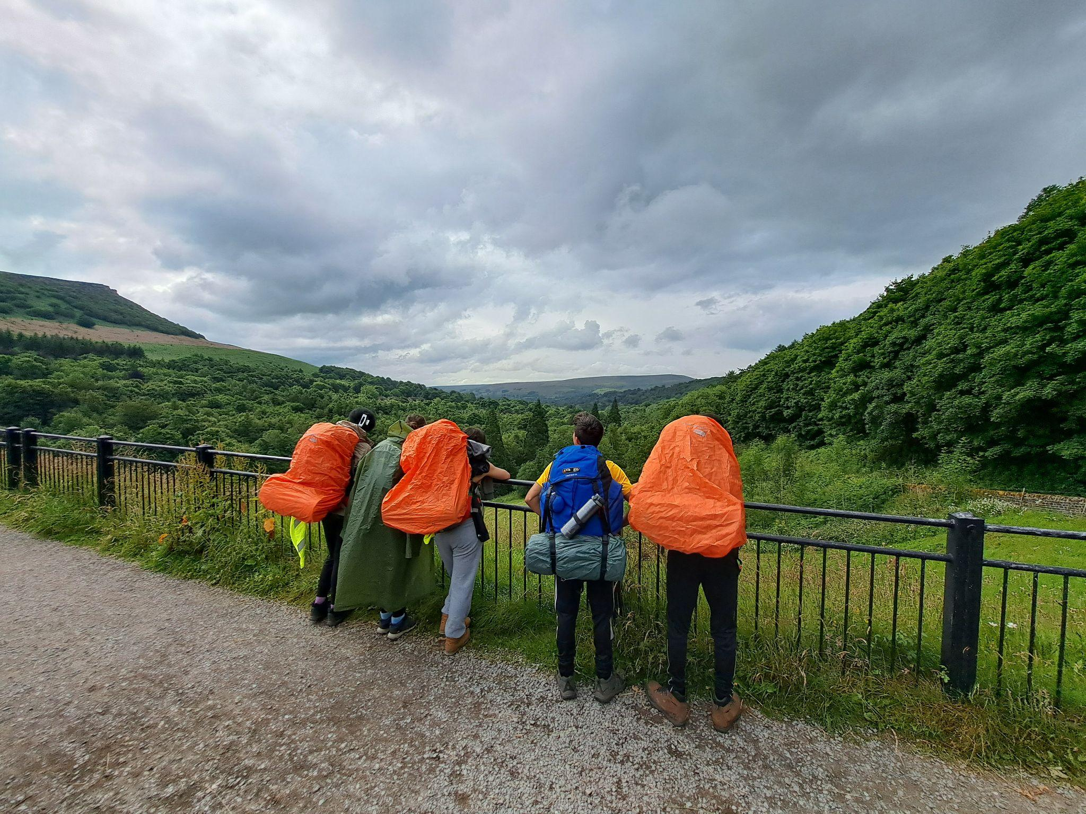

Slide 3
What can you expect from this evening?
Explain the structure of the award and timescales.
Go through some ideas for the three sections.
What is not allowed.
Collecting evidence and Assessor’s Reports
Key dates.
What you can do to help your child.
Opportunity to ask questions.

Slide 4
Students doing the D of E are called participants rather than students.
What is a direct and non direct entrant?
A Direct Entrant is a participant who has not completed their Bronze Award
A Non Direct Entrant is a participant who has completed their Bronze Award
You remain a Direct Entrant until the Bronze is signed off. This has an impact on the timescales you will need to choose (an extra 6 months on one section) so it is in your best interest to finish Bronze before starting Silver whenever possible.

Slide 5
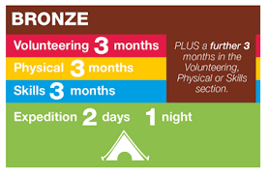
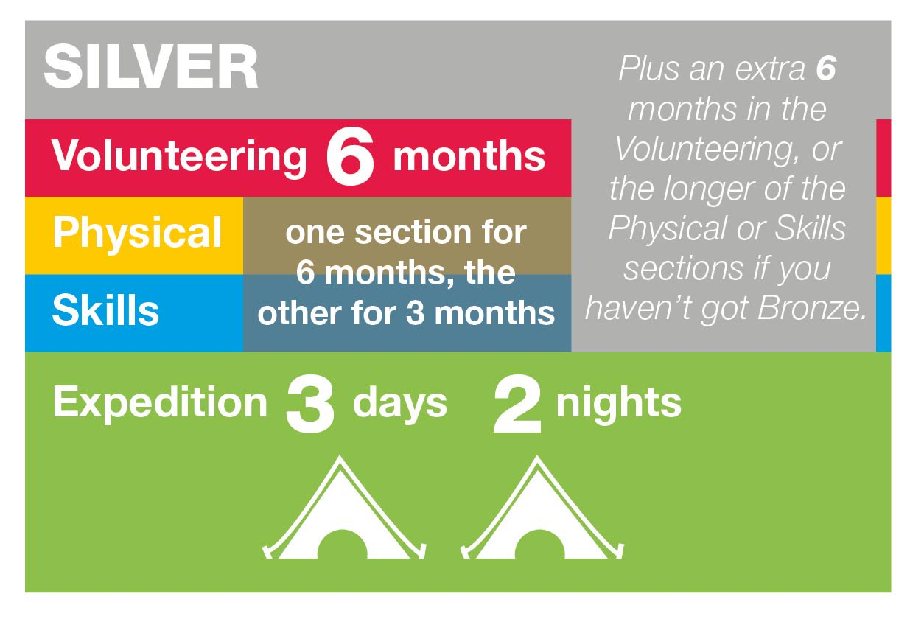
All activity must be at least 1 hour a week for the appropriate period. You can’t do 3 hours a week for one month. You can do 3 days of 20 minutes each.
So a direct entrant to Silver would do a 12/6/3 split (minimum 6 months volunteering)

Slide 6
D of E Process
Think about your options and complete a bitesize programme planner with all the details you will need on enrollment day.
Enrollment on to the course (receive your edofe login)
Enter timescales and put in details of chosen activities on edofe (from bitesize planner)
Log participation (can be backdated to start of September)
Upload evidence on to edofe
D of E manager views and signs off evidence
Upload an Assessor’s Report on edofe
Submit the section for approval by D of E manager
D of E manager checks that the Assessor’s report has all the relevant information.
Section is approved by D of E Manager
Once all sections are approved this goes to the Verifier for a final check.
Certificate is issued.

Slide 7
What are the Four Sections and what can you do for each of them?

Slide 8
Volunteering
Organisations must be non profit
You can not do a job that others would have been paid for.
You can do anything that is unpaid and for the good of the community i.e. litter picking around the local park
Shorter chunks can be added together to make an hour a week.
Try to find an opportunity that is meaningful to you rather than just to tick the box.
Work in pairs/groups if you like.
Don’t forget to get each session initialled by an adult on a participation log.

Slide 9
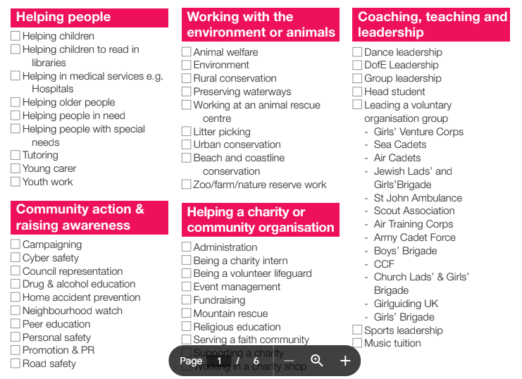

Slide 10
Physical
Can be any sport or physical activity
There is a 13 week fitness at home programme dofe.org/centre
Use Strava or other apps for evidence
Use walking as prep for the expeditions
You can use activities that you are already doing but we would rather they were new.

Slide 11
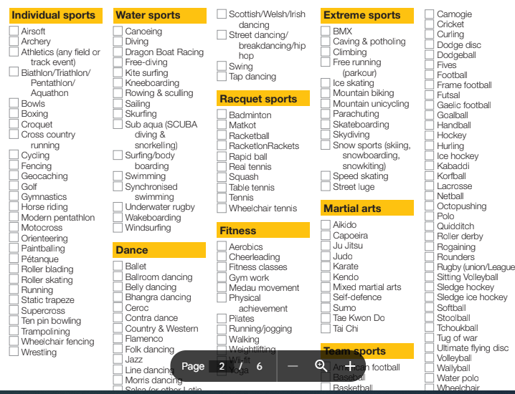

Slide 12
Skills
Can not be a sport i.e. improve soccer skills. However, you could be doing football for a physical and also volunteering at the football club
IBM skills Build https://www.dofe.org/shop/ibm-skillsbuild/
Online courses

Slide 13
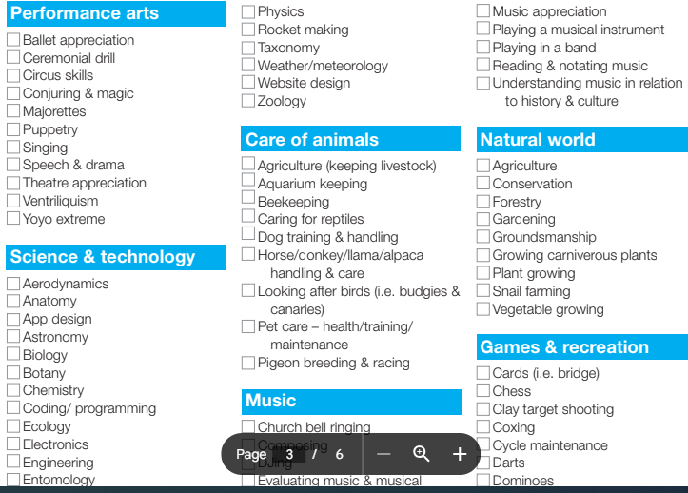

Slide 14
Collecting evidence and Assessor’s Reports

Slide 15
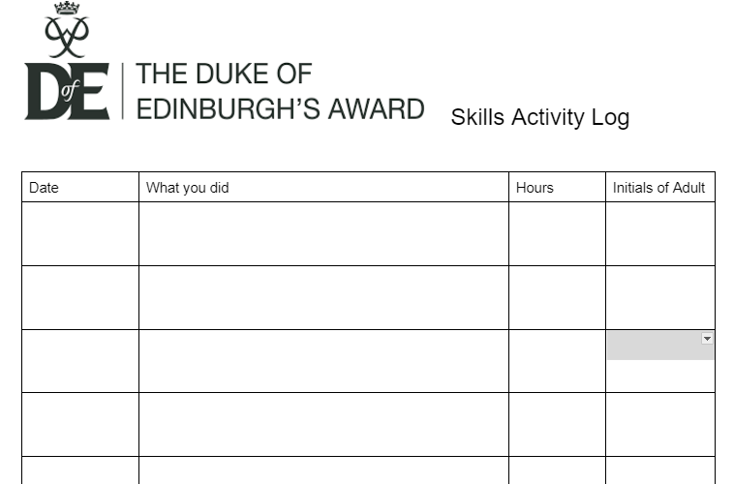

Slide 16
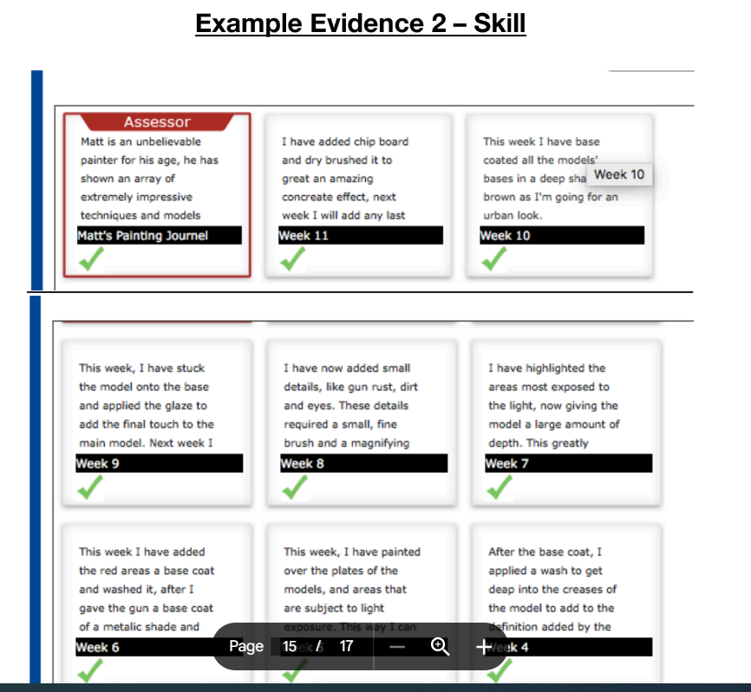
Try to ensure that the evidence shows some progression.
I.e. complexity in a recipe or improvement in times

Slide 17
Assessor’s Reports
Doesn’t have to be the person who has signed participation log.
Can NOT be a member of close family
Can be a coach/leader/family friend/teacher
Short paragraph/not a big job. Looks at participation log, has a conversation with the participant.
Use the Assessors Portal https://www.dofe.org/assessor/ or paper copy in D of E pack
Must include dates, durations, what they did
Can include reference to how well they did and what they learned.
YOUR SECTION CAN NOT BE SIGNED OFF WITHOUT A VALID ASSESSORS REPORT!

Slide 18
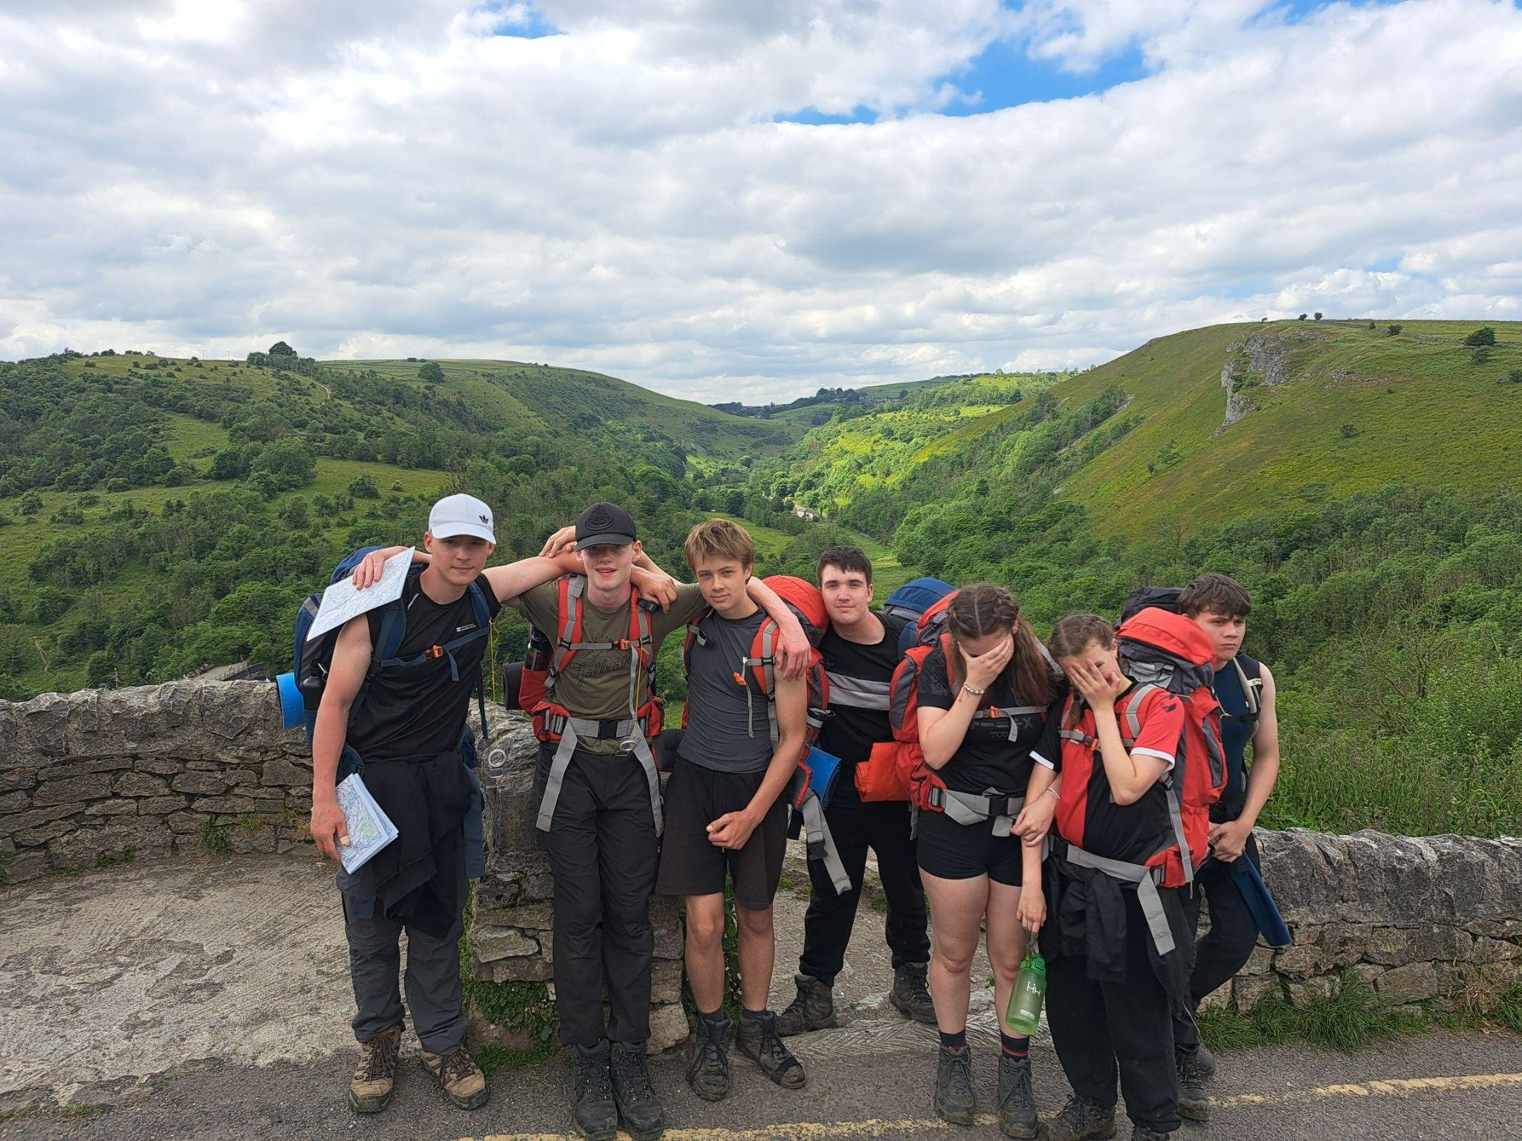
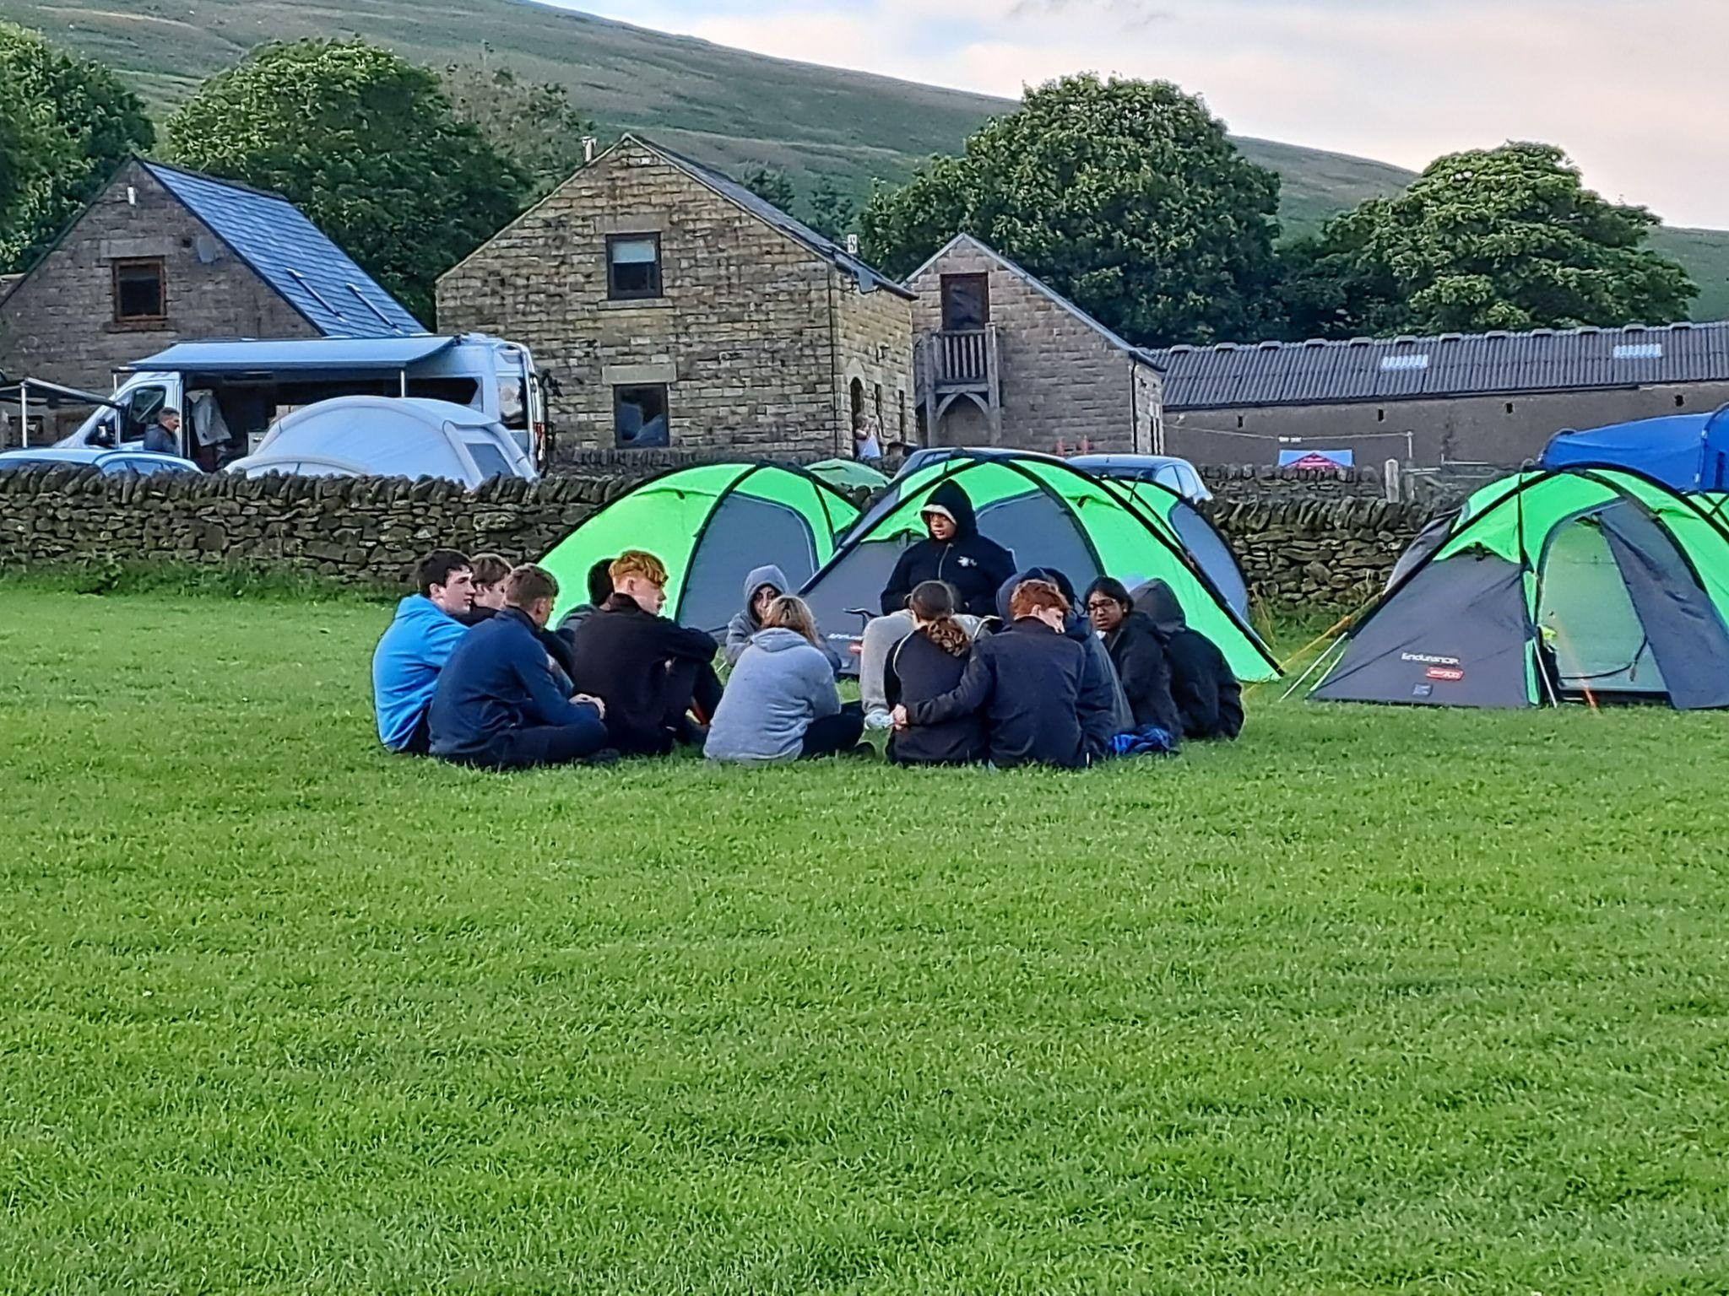

Slide 20
Expeditions
Bronze Practice April 24-25 Friday and Saturday Local just north of Rugby
Bronze Qualifier June 13-14 Saturday and Sunday Around the Ullesthorpe area
For the Bronze expeditions we ask parents to deliver participants to the start point and collect on day 2 at a designated finish.
Silver Practice May 14-16 Thursday eve to Saturday Eve Bakewell, White Peak District
Silver Qualifier July 3-5 Friday to Sunday Long Mynd Shropshire Hills
For Silver expeditions we transport participants via minibus from Harris Sports Centre.

Slide 21
Expedition Equipment:
We provide all tents, stoves, fuel, rucksacks, maps, compases (some sleeping bags, roll mats available)
What you will need to provide: Boots, Waterproofs, food, sleeping bags, roll mats
You get between 10% and 15% of with your D of E card in shops like Blacks, Go Outdoors, Milletts
Training: On site training days April 7th Bronze April 8th Silver.
After school training sessions
Day one of Practice Expeditions are spent with a leader

Slide 22
How can parents help their child complete the award?
Help log their participation in the three sections by initialling the participation logs.
Have regular progress checks to see how they are getting on if you are not the adult signing participation logs.
Help them to find an adult that will act as the assessor. (Form teachers are often a good option for this if they are stuck)
Don’t do too much for them. The award is about developing their independence.
Encourage them to complete as quickly as possible.

Slide 23
Any other questions?
david.unwin@harris.covmat.org

