Slide 1


Slide 2
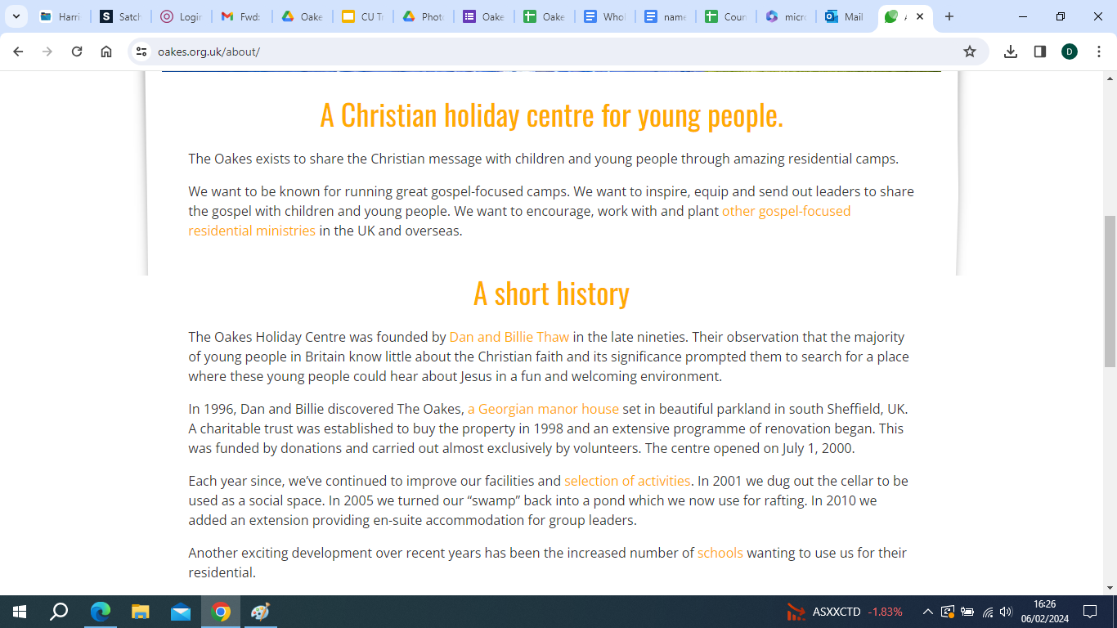

Slide 3
Agenda for this evening
A little about the Oakes
Who is accompanying your child
Travel arrangements
Medical arrangements
Sleeping arrangements
Activities
Packing advice
Camp rules
Emergency contact details
Consent Forms and Booking in

Slide 4
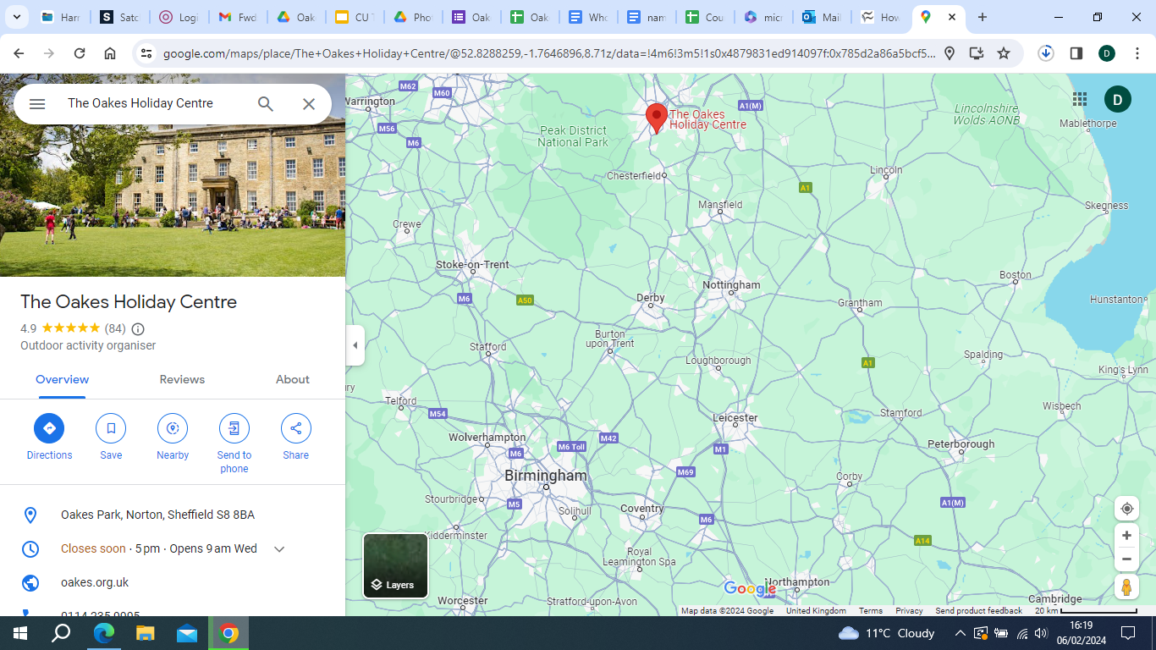

Slide 5
Aims of the trip
To build relationships and teamwork skills between the students, especially members of the Christian Union
To increase our understanding of what it means to be a Christian in the 21st Century.

Slide 6
Who is going?
47 Students from Year 7-11
Miss L Bastos
Mr S Smith
Mrs V Hobbs
Mrs S Roberson

Slide 7
Travel Arrangements – Arriving at school
Non-uniform for the day
08:00-08:30: Arrive at Harris Sports Centre before school with your luggage. 79 Mellish Rd, Rugby CV22 6BB
Check in with Miss Bastos then take your luggage to Dance studio
Give Mrs Hobbs any authorised medication. Make sure it is labelled.
You will place your luggage in the area marked with your Year group. Make sure you can carry it!!!
If you cannot come to the Sports centre entrance then you will need to come from the main School entrance through the green gates by the Humanities block/minibuses to the sports centre.

Slide 8
Travel Arrangements – Going to the Oakes
12:20 (After P3) Go to the toilet.
Take your school bag to Mr Smith in the Fitness suite. It will be safely locked away for you over the weekend.
Retrieve your own luggage from the Dance studio.
Register with Miss Bastos in the Reception area of the Sports centre, then hand over your luggage to the coach driver.
Get onto the coach with a small piece of hand luggage, containing any spending money for the journey. Make sure you have already taken your travel sickness tablets at break and have your inhalers with you.
Approximately 12:30 Leave Harris
14:20 Stop for food at the Motorway service station just before Sheffield (Woodall Services Northbound S26 7XR)
15:00 Meet back at the coach
15:15 Arrive at the Oakes

Slide 9

Medication
As per school policy non-prescribed medications and inhalers will be the responsibility of the pupil. They must
be in the student’s hand luggage.
If you have prescribed drugs that you would like us to look after for you, then you will need to fill in a medication form (available on the website or we can email it to you.) These will then be handed over to Mrs Hobbs when you arrive at school on the day of the trip. It must be clearly labelled with your child’s name and in a sealed bag
Travel sickness tablets must be taken in advance.
If there is any special information that we need to know about how to care for your child effectively, please make sure it is on the Google Form. If you have already completed this and want to add information please email Miss Bastos at luana.bastos@harris.covmat.org

Slide 10
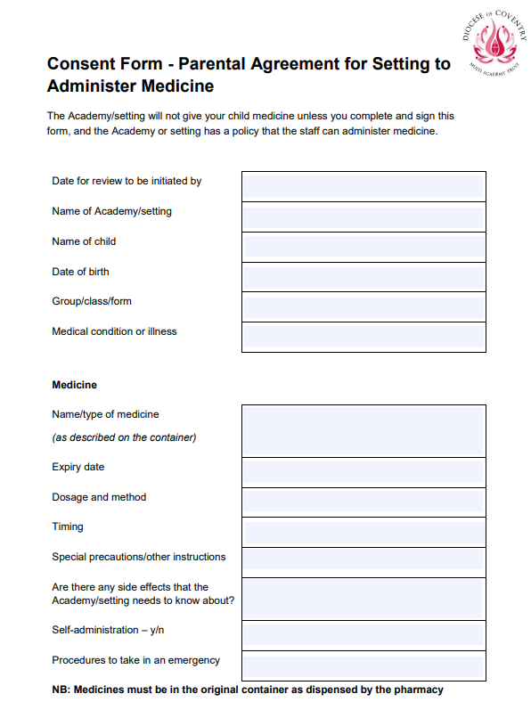
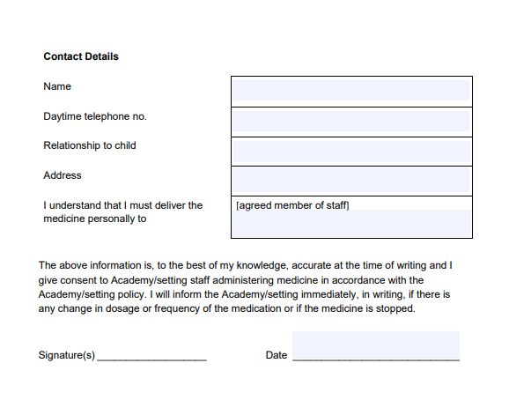

Slide 11
Supervision
Overall responsibility will be taken by Harris staff and anyone not behaving according to our behaviour policy will have to be collected and returned home ☹
During all practical activities they will be supervised by fully qualified members of staff from the Oakes who have all been DBS checked and trained to British Safety Standards.

Slide 12
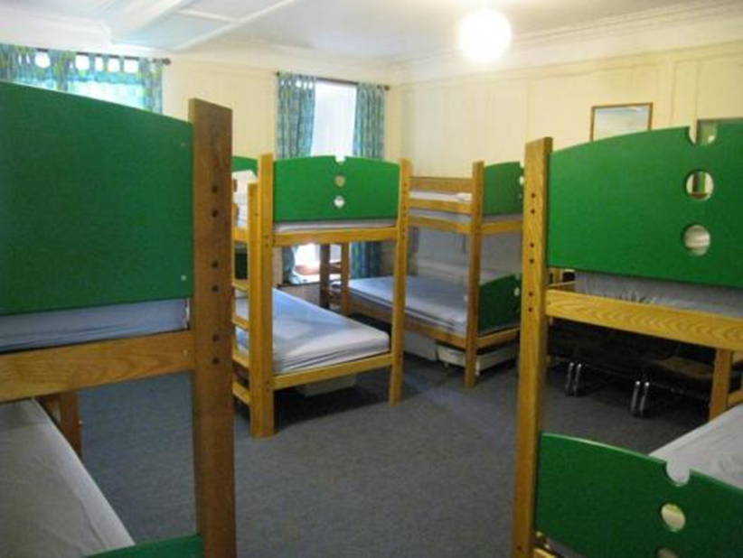
Sleeping Arrangements
We have a total of 4 Dorms.
  Carmichael & Taylor (These two are the girls dorms)
  Slessor & Livingstone (Boys dorms) .
Bring a sleeping bag, non-fitted sheet and a pillowcase with you!

Slide 13
Sleeping Arrangements
Carmichael Year 7 and 8 Girls
Taylor 1 Year 9 Girls
Taylor 2 Year 10 and 11 Girls
Slessor Year 7 and 8 Boys
Livingstone 1 Year 9 Boys
Livingstone 2 Year 10 and 11 Boys

Slide 14
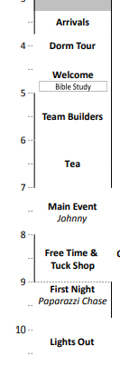

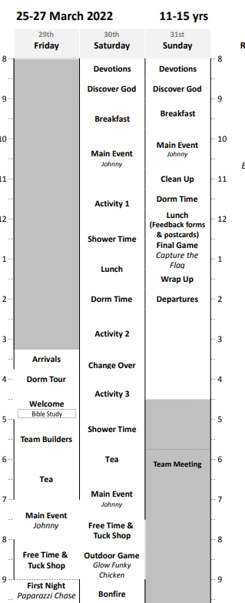
What will we be doing?
FRIDAY
SATURDAY MORNING
SATURDAY pm
SUNDAY

Slide 15
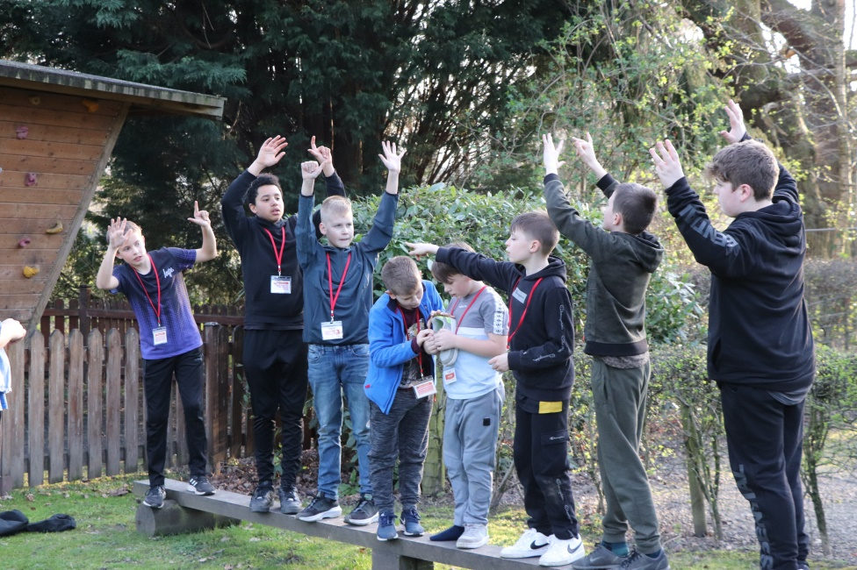
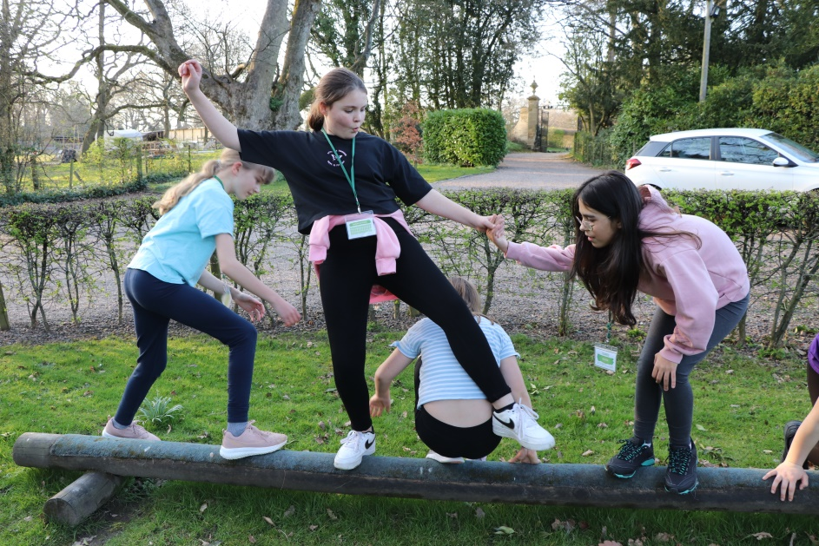
What will we be doing?
Let’s have a look at some photos from previous years

Slide 16
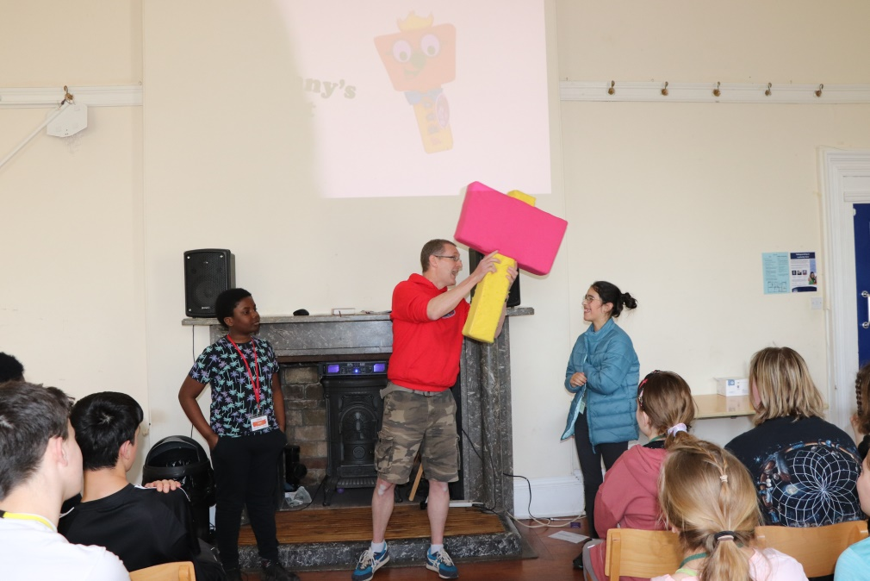
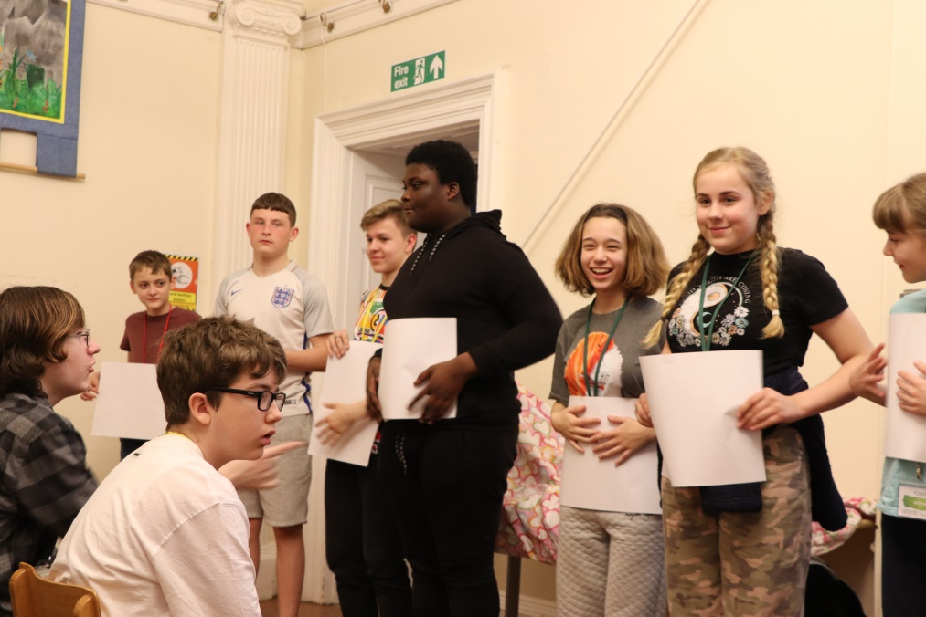
Let’s have a look at some photos from previous years

Slide 17
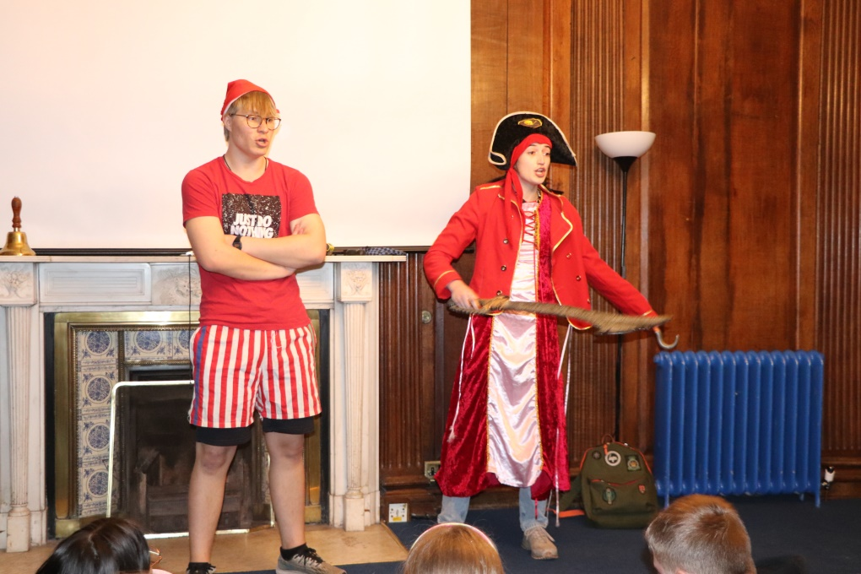
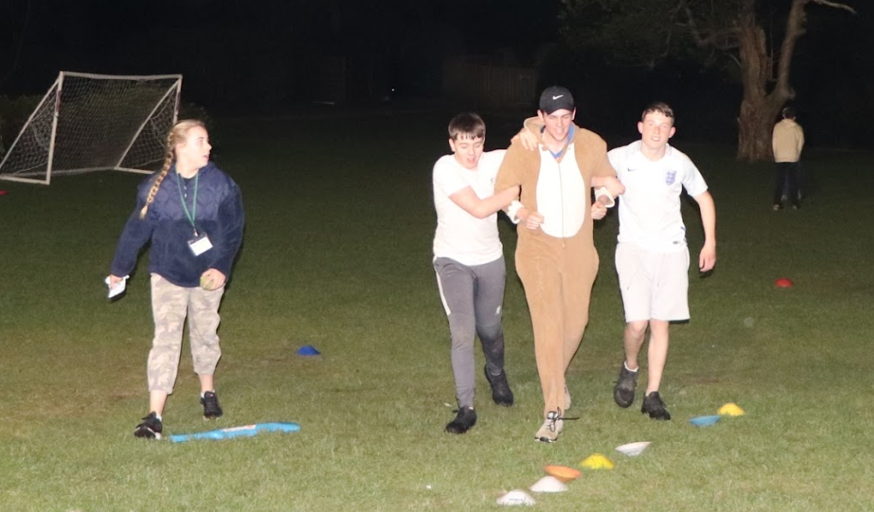
Let’s have a look at some photos from previous years

Slide 18
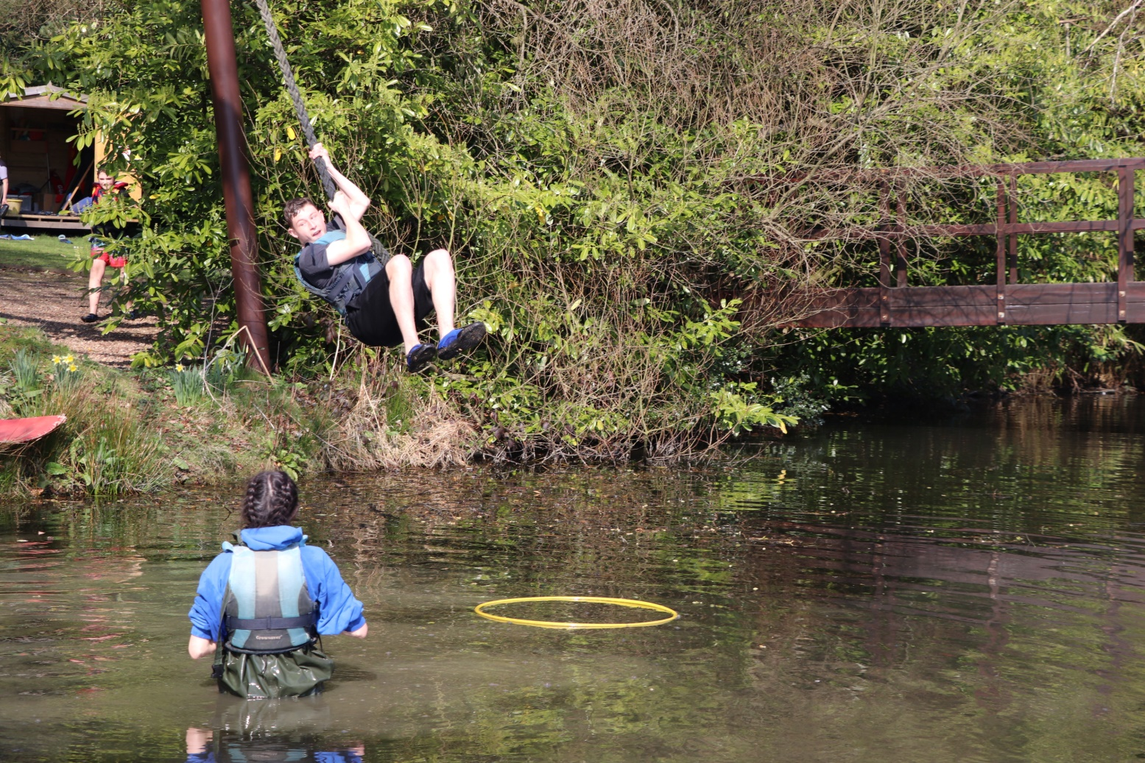
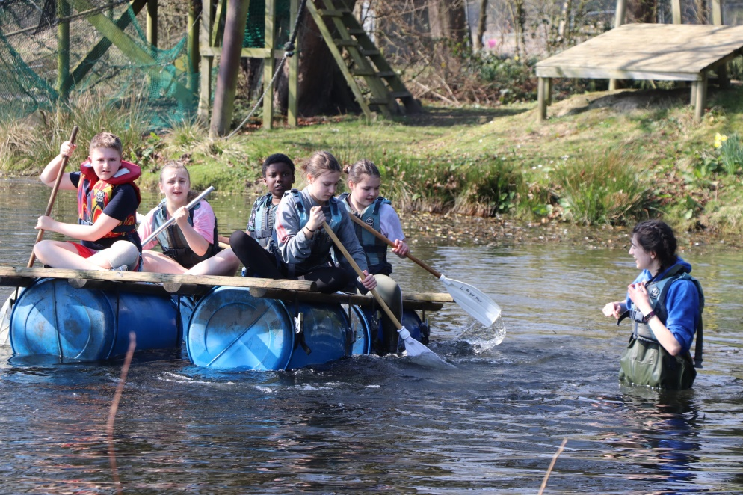
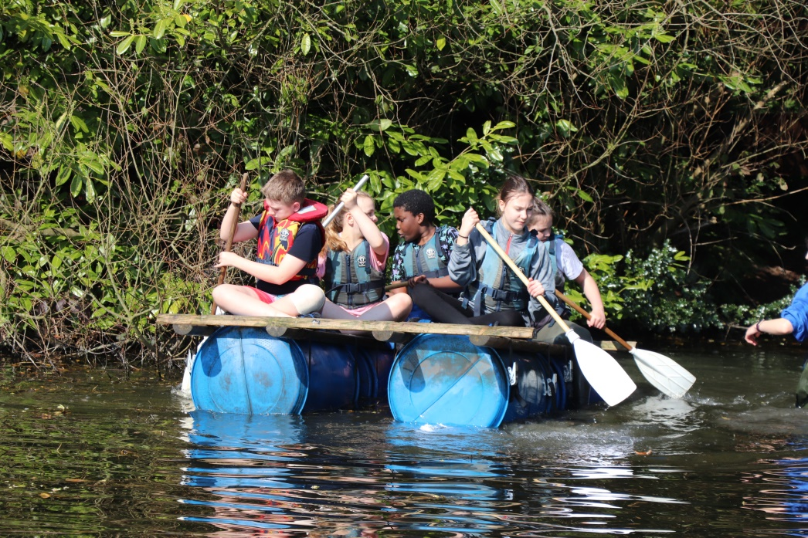
Let’s have a look at some photos from previous years

Slide 19
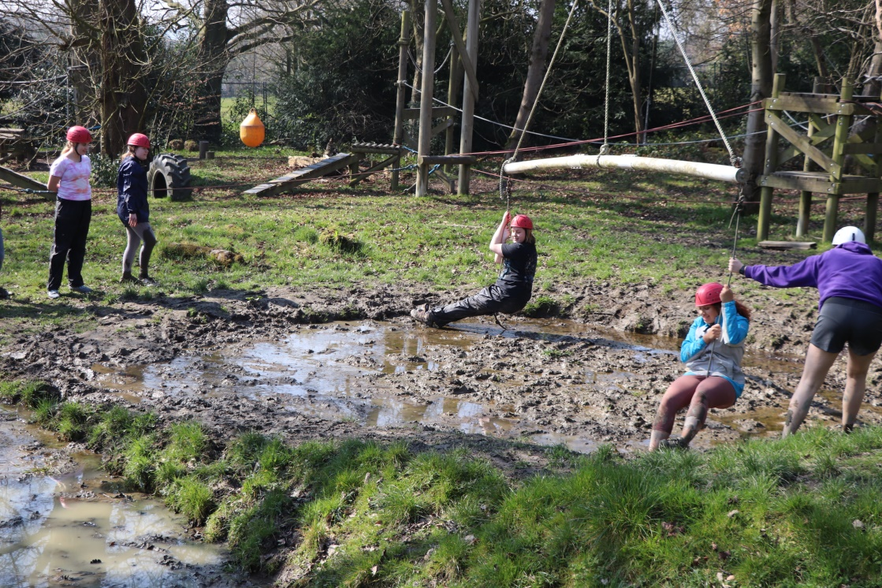
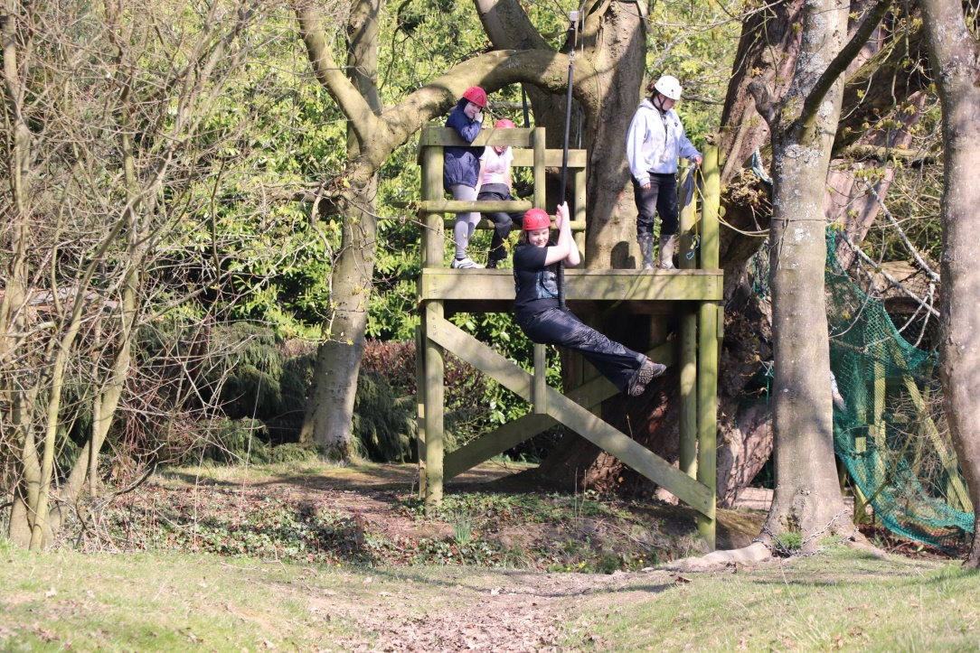
Let’s have a look at some photos from previous years

Slide 20
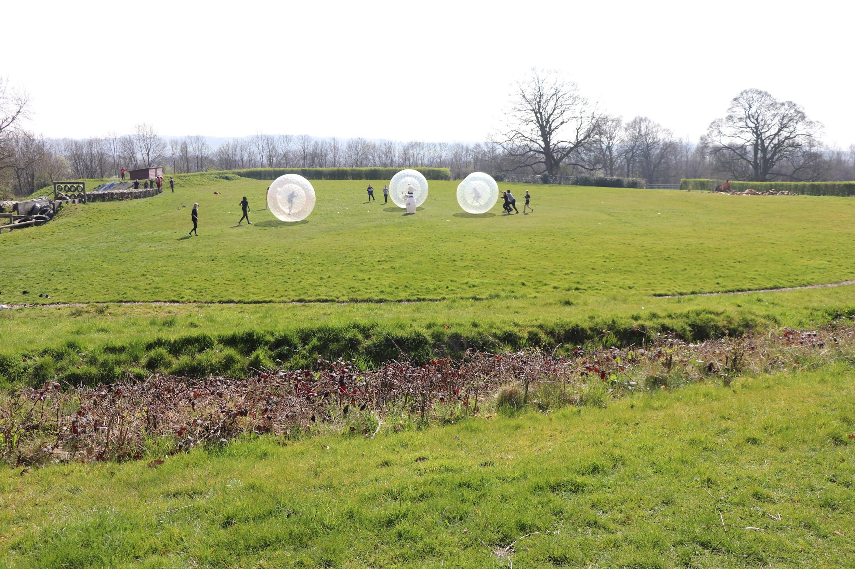
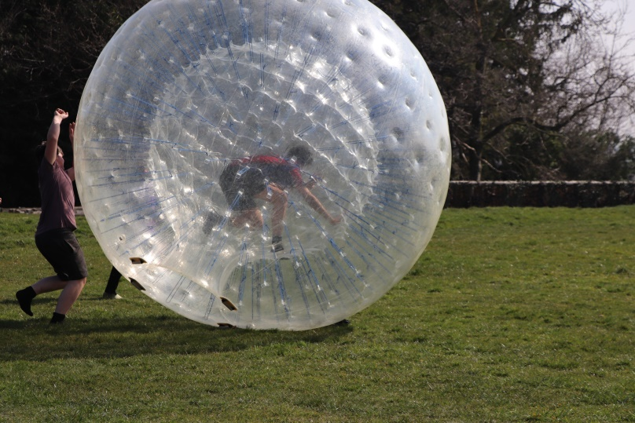
Let’s have a look at some photos from previous years

Slide 21
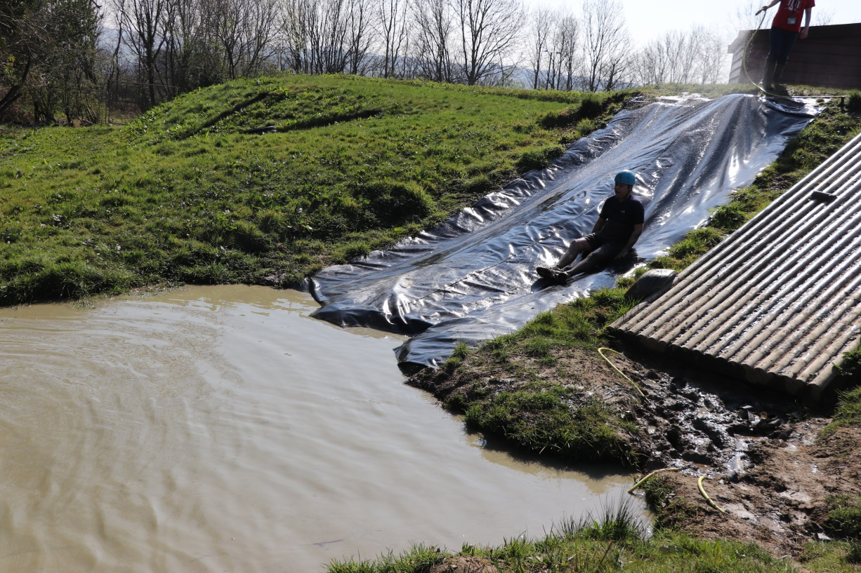
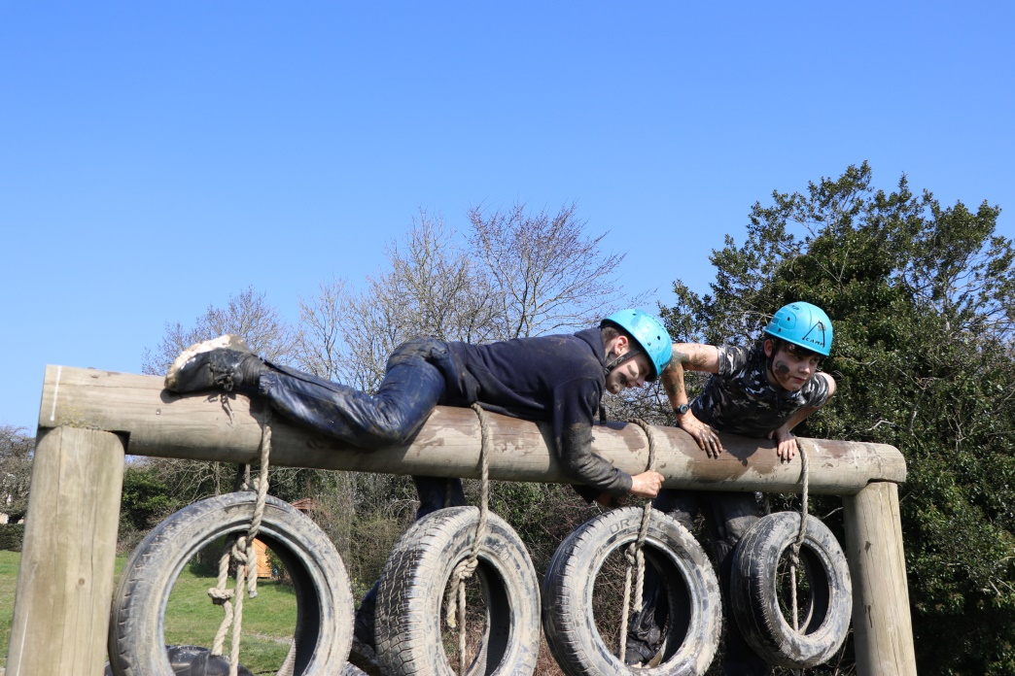
Let’s have a look at some photos from previous years

Slide 22
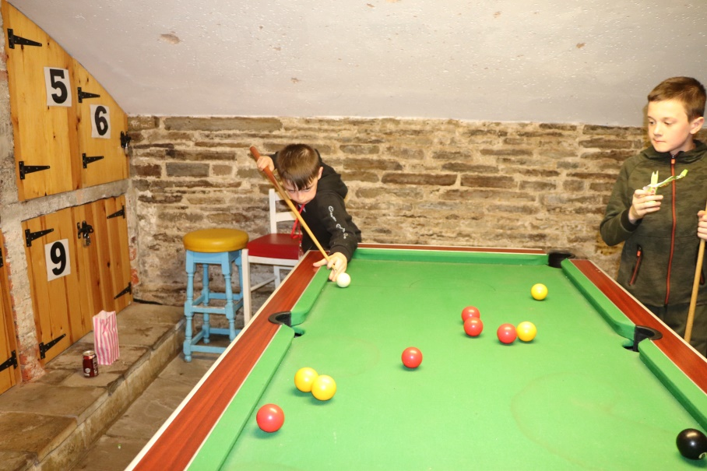
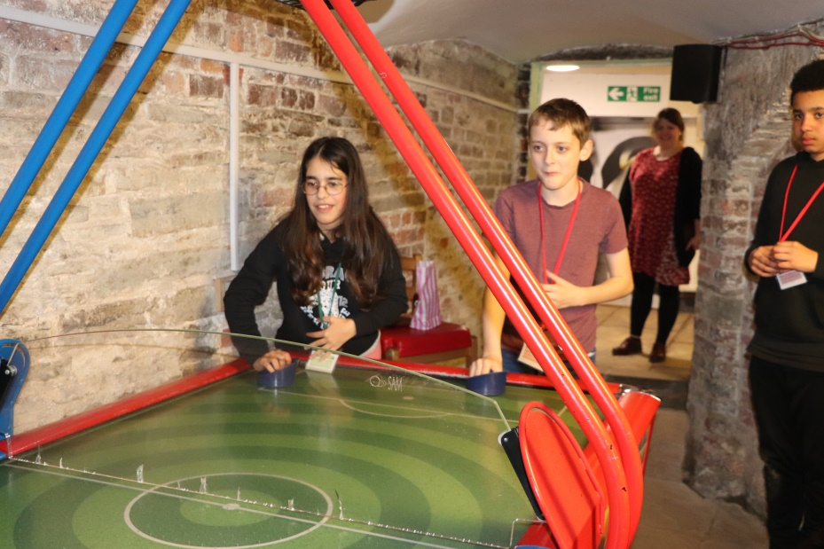
Let’s have a look at some photos from previous years

Slide 23
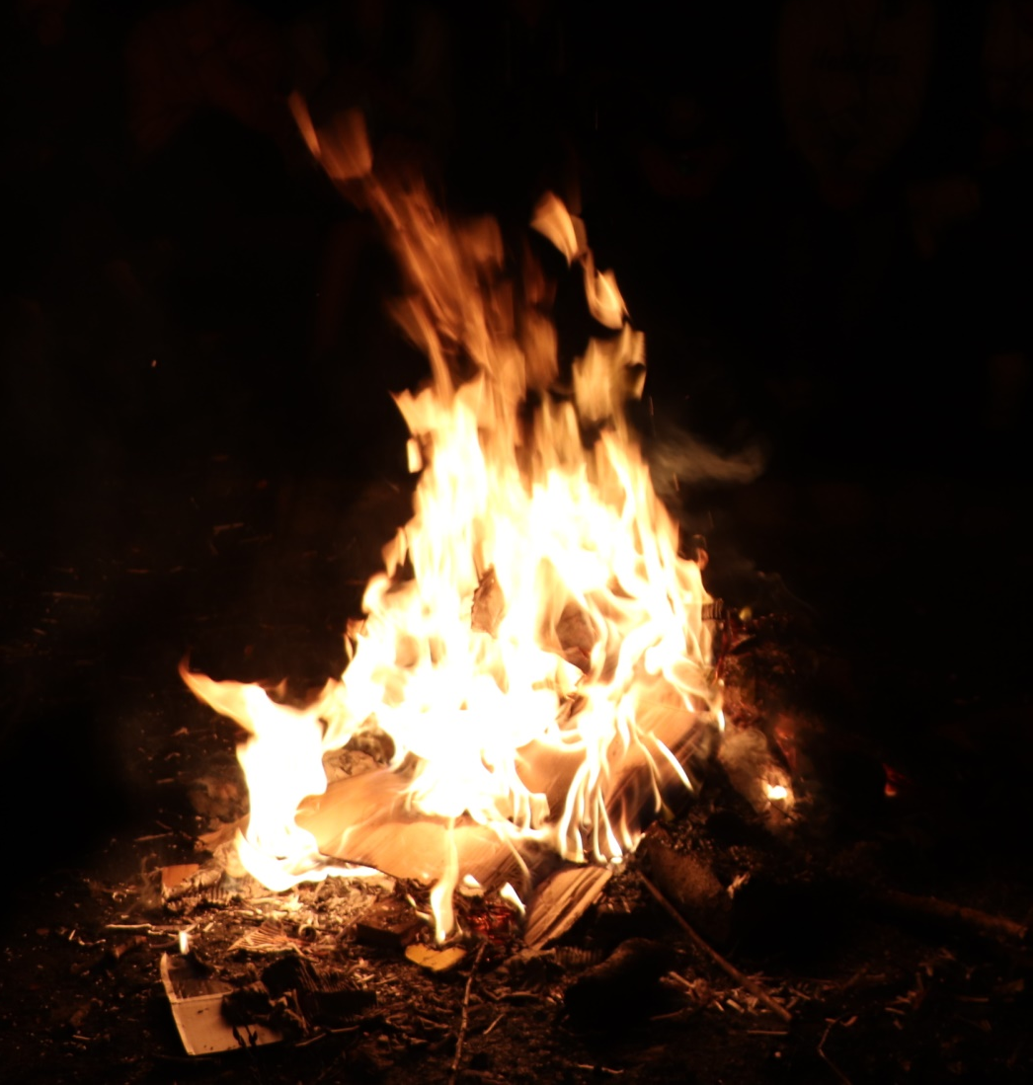
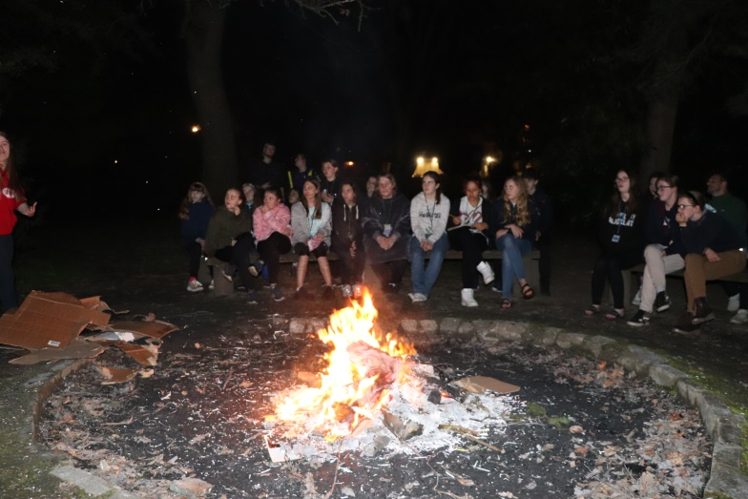
Let’s have a look at some photos from previous years

Slide 24
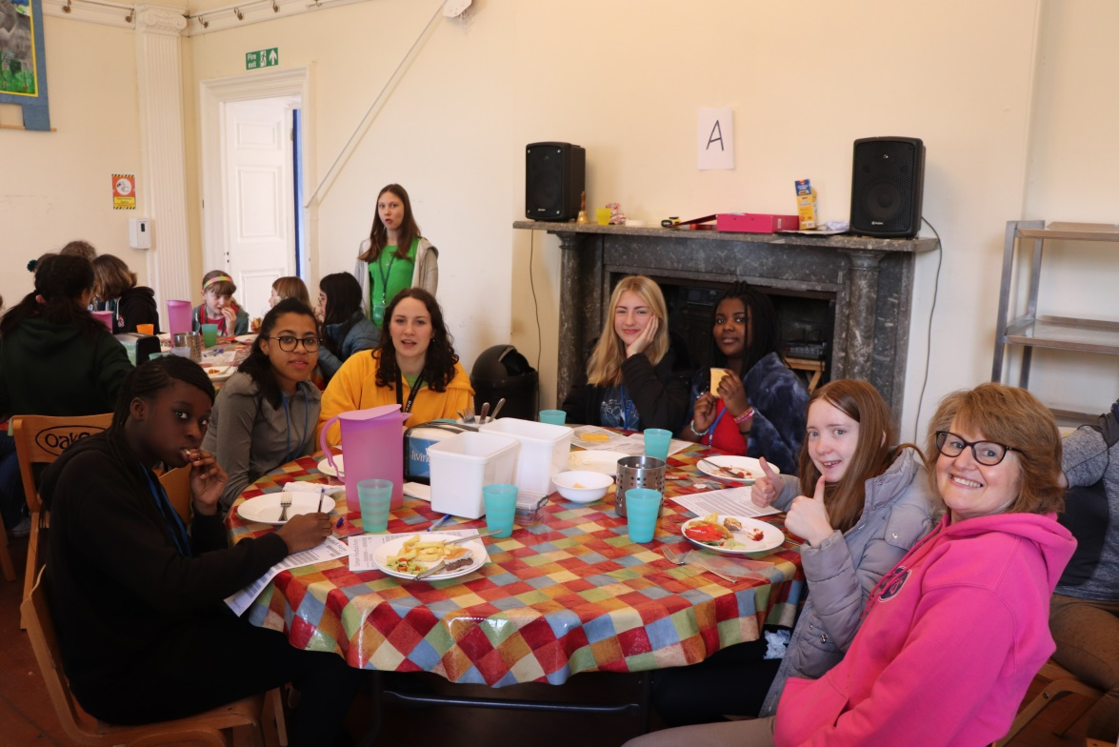
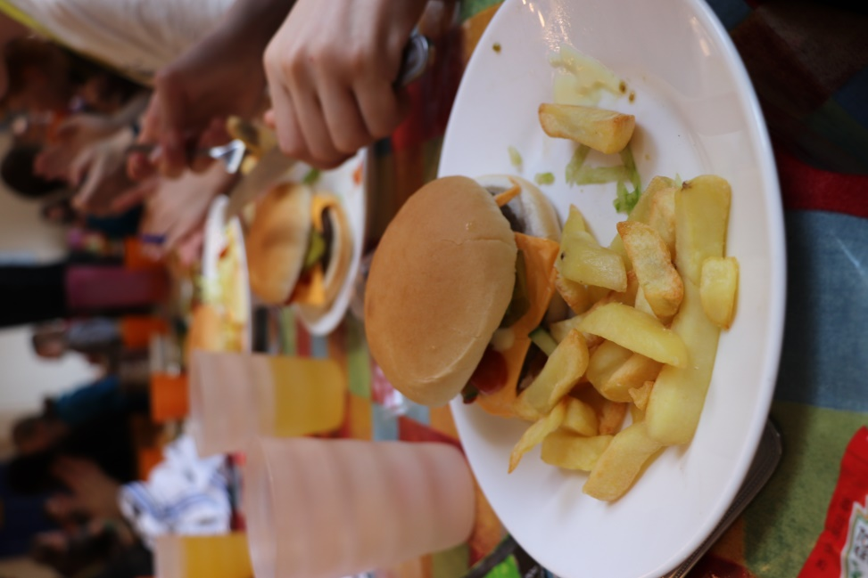
Let’s have a look at some photos from previous years

Slide 25
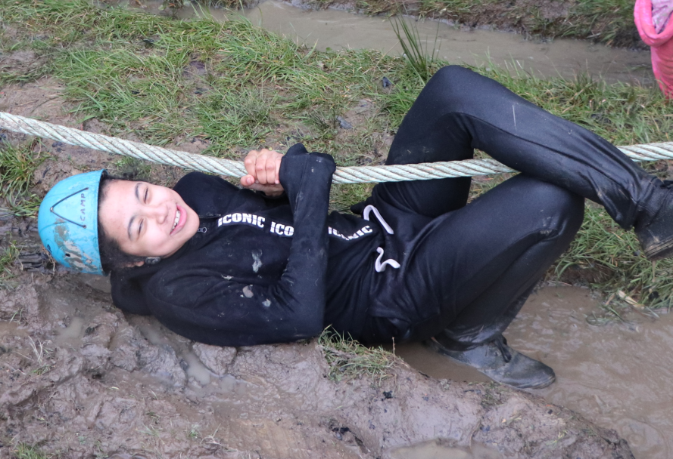
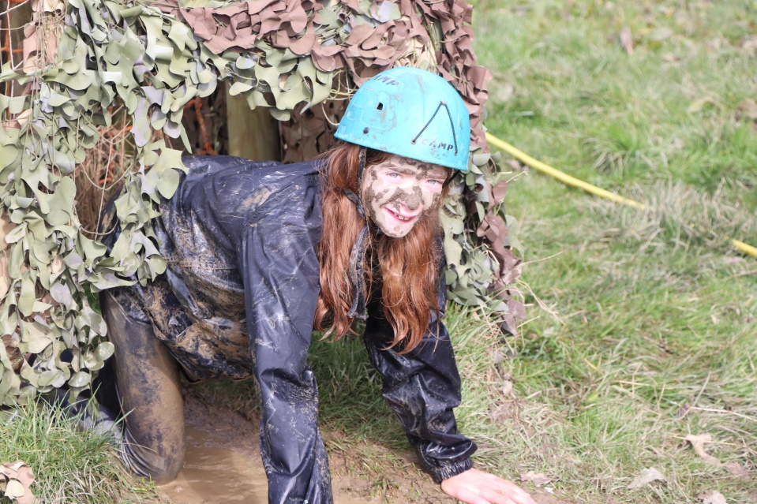
What to bring…
See the packing list
I’ll email this PowerPoint, but the list can be downloaded off the Oakes website
Main thing is to make sure you have enough clothes! Things you don’t mind getting wet and muddy!!! Please label as much as possible.
Black bin liners are always useful to store dirty clothes
Waterproof coats and trousers

Slide 26
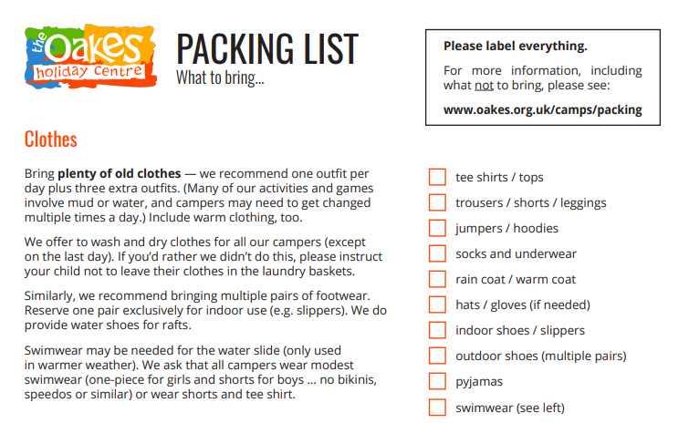

Slide 27
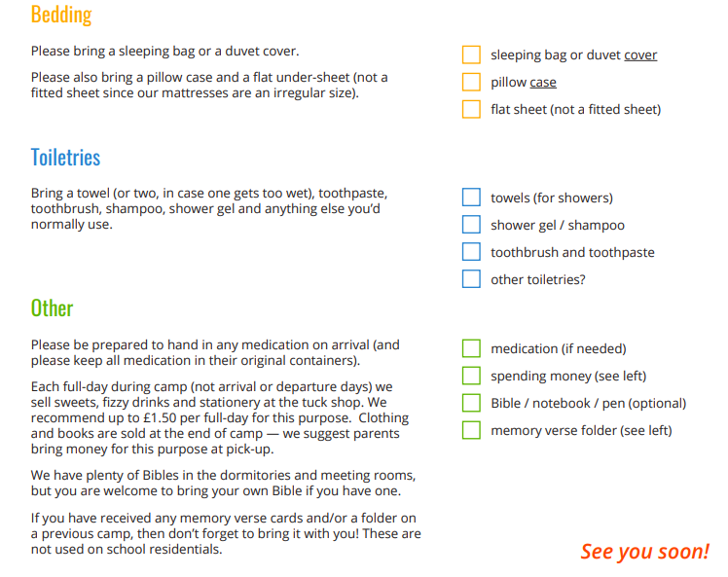

Slide 28
What NOT to bring ...
Entertainment
The Oakes programme is action-packed and there are plenty of things to do in free-time. We recommend leaving items such as sports equipment and books/magazines at home.
Phones & Electronics
Phones and other electronics can be very distracting and may get lost or damaged.
These will be collected in on arrival and returned at the end of camp.
Valuable Items
Sometimes things get damaged or lost, so please avoid this by leaving expensive items or items of sentimental value at home.
Nutty Snacks
Please don’t bring snacks that contain nuts or peanuts – even traces. Nuts and peanut allergies are fairly common and we wouldn’t want to make anyone ill, would we?
Obvious Stuff
No alcohol, drugs (except for prescribed medication), weapons, fireworks … you get the idea. These will be confiscated and reported if appropriate.

Slide 29



Electronics!
Mobile phones and other electronics will be allowed on the journey, but no electronic “gadgets” will be allowed in the Oakes.

Slide 30
Spending money…
Refreshments for the motorway stop! We are not providing lunch apart from the packed lunches for Free School Meals
Tuck Shop - This will be open once on the Saturday, and once on the Sunday. They are limited to £1.50/day on sweets/drinks
Oakes Merchandise - Clothing and books are usually sold at the very end of camp. They can spend as much as they like on merchandise.
  Tee shirts cost £7 – £8
  Hoodies cost £16 – £18 (dependant on size).
Money getting lost

Slide 31
Travel Arrangements – Return to Rugby
Have Sunday buffet lunch
13:45 Load the coach
14:00 Leave the Oakes ☹
15:45 – 16:00 Arrive back at Overslade Road (providing that there are no hold ups on the motorway)
The gates of the School will be opened for parent parking on site at 15:45.
Please do not park in Overslade Lane as you will need to sign your child out with a member of staff before we let them off site.

Slide 32

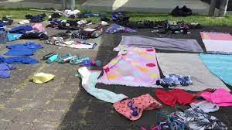
Retrieving Luggage and Lost Property
Students retrieve their luggage from the coach and bring it with them into the school main car park, where they can hand it over to parents/carers.
Students retrieve their school bags from the Fitness Suite with Mr Unwin. They will need to walk around the outside of the school and go through the back entrance of the Sports Centre.
Lost property will be displayed outside the School. Parents/students check the lost property to make sure that they haven’t left anything!

Slide 33
Your Child’s Safety
Students must not leave the school site until they have checked out with one of the members of staff who will dismiss them with their parent/carer.
    Boys with Mr Smith
    Girls with Mrs Hobbs

Slide 34
In an emergency…..
If you need to contact us urgently during the weekend the details are:
The Oakes Holiday Centre
Tel: 0114 2359995

Slide 35
Medical Forms/Consent/Booking Forms
Please ensure that you have completed the following:
The Oakes Booking Form via the link to the Oakes website
The Google Form giving medical consent and contact details
Both can be found on the email sent to you last week.

Slide 36

Any Questions?
www.oakes.org.uk/harris
luana.bastos@harris.covmat.org

